Slide 1


Slide 2
Happy 1st Birthday, SIMON!
September 15th, 2021
Notes:
Welcome all! We’ll get started soon.

Slide 3
Notes:
Thank you all for joining us for SIMON’s one year birthday party! As we go through the presentation should you have questions please post them in the chat and our team will answer as many as possible, any we don’t get to will be answered and posted with the recording of this presentation on the SIMON Website.
This is a special day for us, and for South Carolina as we reflect on a full year since we implemented the Statewide Immunization Online Network (SIMON). An IIS is a database that records all the vaccine doses administered by participating providers to patients. Having an IIS is a vital part of disease surveillance, outbreak management, and vaccine program continuous quality improvement. Implementing an IIS is a crucial advancement and… (slide)

Slide 4
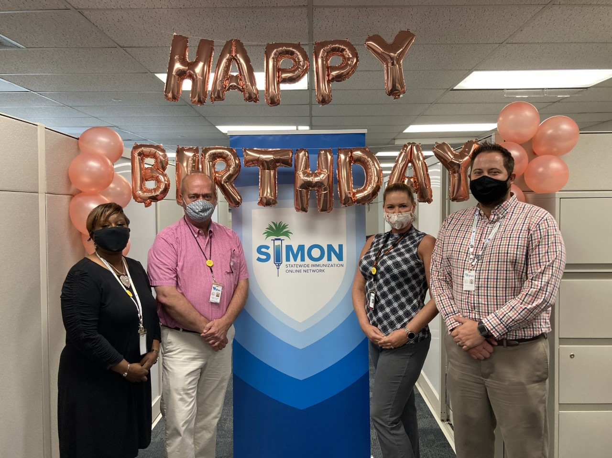
Immunizations Leadership
Notes:
…shoutout to these brave leaders who implemented a whole new state system in the midst of a pandemic! They had no idea what they were in for. Let’s take a little trip down memory lane…
Stephen White, Division Director
Wendell Gulledge, Assistant Director
Chrystal Gasowski, Interim IIS Manager
Sherell Stevens-Masten, VFC Operations Manager

Slide 5
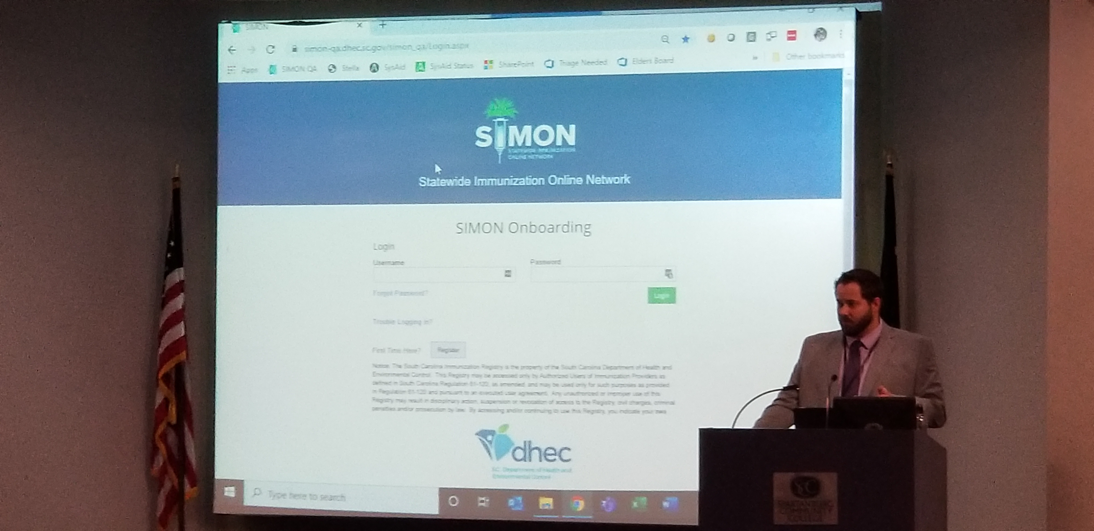
Notes:
In February of 2020, DHEC’s Division of Immunizations hosted “Introduction to SIMON” presentations around the state. Our vendor partner, Envision, brought it’s training team to provide demonstrations of the features and functions of the new Immunization Information System.

Slide 6
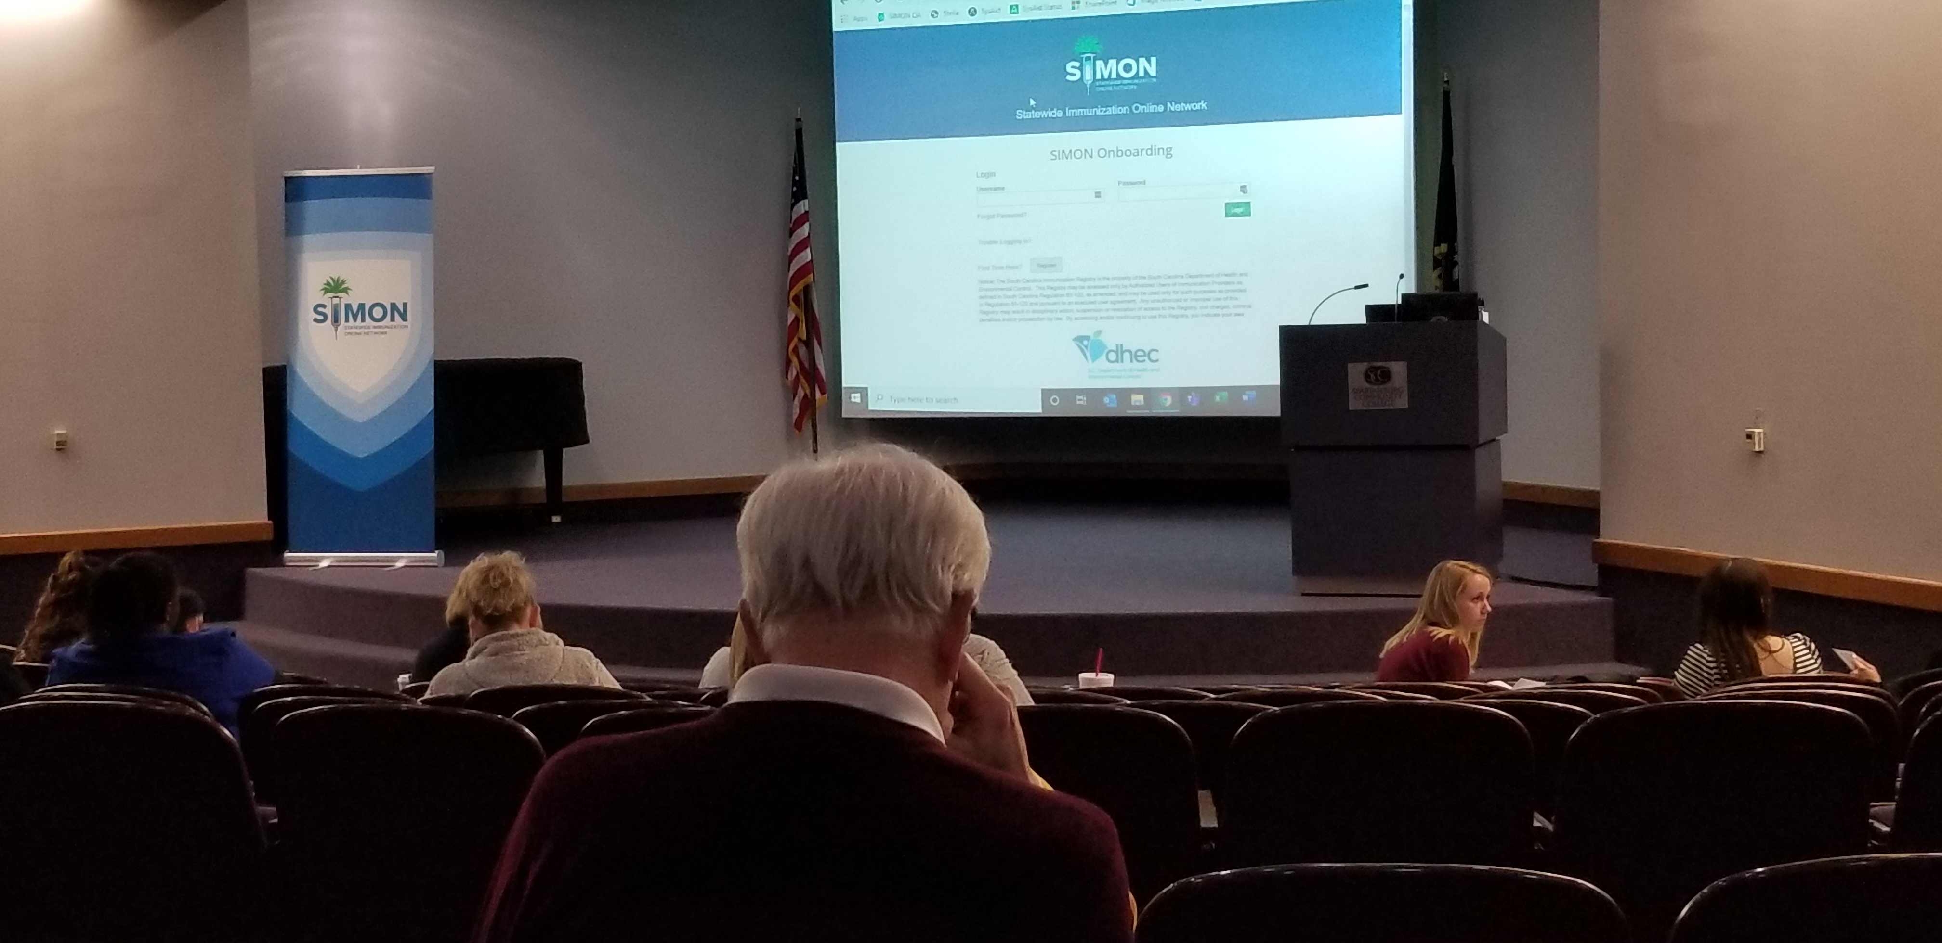

Slide 7
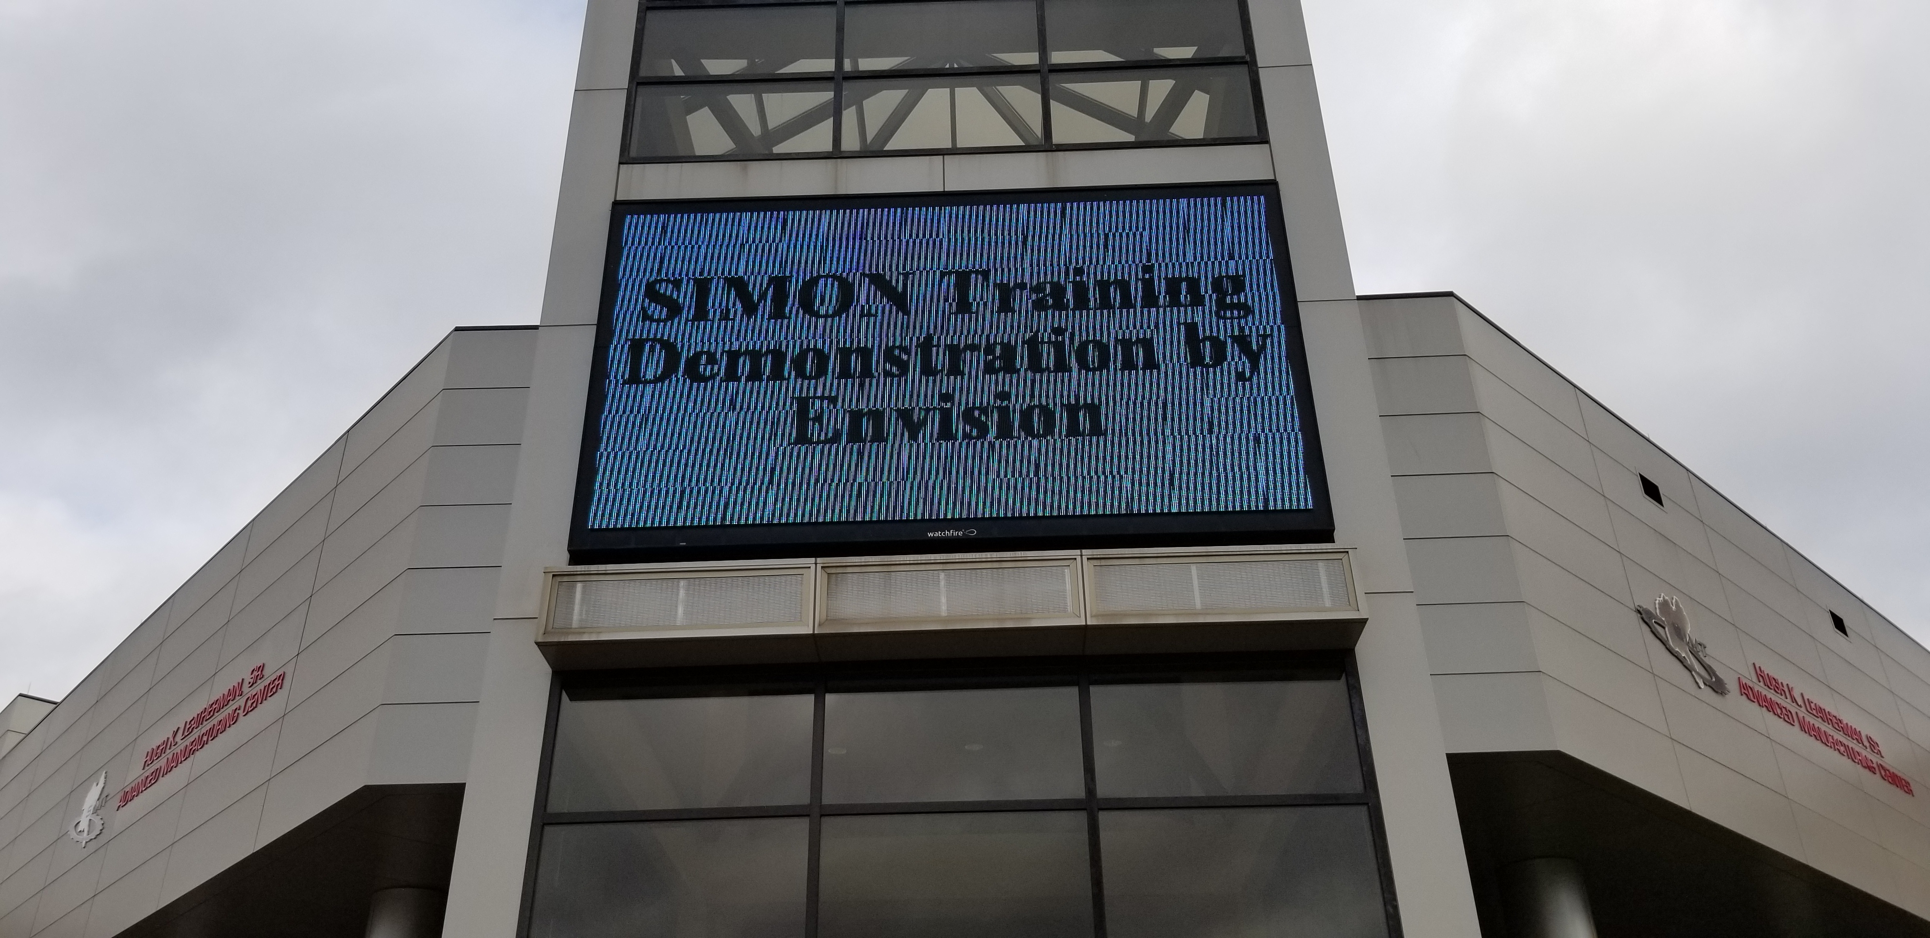
Notes:
At the presentation for the PeeDee Region at the Southeastern Institute of Manufacturing and Technology we got “top billing” .

Slide 8
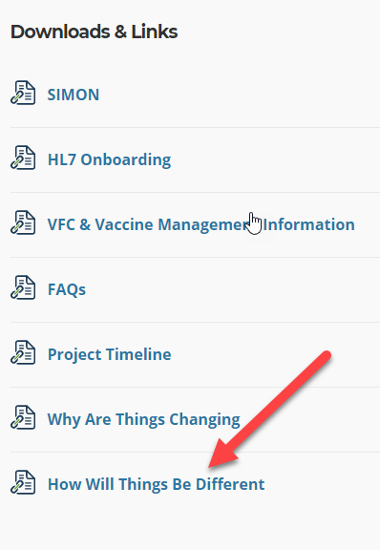
Top 5 SIMON Benefits
The Top Reasons We’re Excited about SIMON
Meets the requirements for stage 3 meaningful use.
Improves VFC provider experience with simplified enrollment and online vaccine ordering.
SCIApps was replaced with the Statewide Immunization Online Network (SIMON).
Provides EHR vendors streamlined HL7 onboarding functionality to test and validate messages. Communicates seamlessly with provider EHR through bi-directional messaging.
Generates provider-level immunization coverage reports for quality improvement efforts.
Notes:
Here are some of the benefits that made us so excited about SIMON.

Slide 9
System Features
Vaccine management functionality including inventory, ordering, transfers, wastage, and storage unit features.
Brand-new data quality features which ensures a more reliable system is maintained.
Reminder recall feature to identify providers patients who are due or late for immunizations.
Upgraded reporting capabilities for clinicians including provider site, region and population characteristics.
Enhanced electronic exchange with EHR systems including forecast feature.
HL7 onboarding which allows providers to validate and submit messages before being promoted to an active HL7 test facility.
Vaccine deduplication features that help consolidate records from multiple providers into a single record for each patient.
Notes:
System features that would bring new functionality to the Immunization Information System.

Slide 10
SIMON Supports the Entire Immunization Partner Community
Private clinics - The new system satisfies VFC requirements for quality improvement, reporting, and monitoring activities (AFIX/IQIP).
School Nurses - School nurses are able to group students and access reporting tools.
Local Public Health Agencies and VFC Providers - Providers are now able to reconcile vaccine inventories monthly within SIMON.
EHR vendors - Are able to onboard clients within the application with minimal wait times. The new SIMON has an HL7 onboarding module to test and validate messages.
Notes:
SIMON supports the entire immunization partner community with benefits to Private clinics, School nurses , Local public health agencies and EHR vendors.

Slide 11
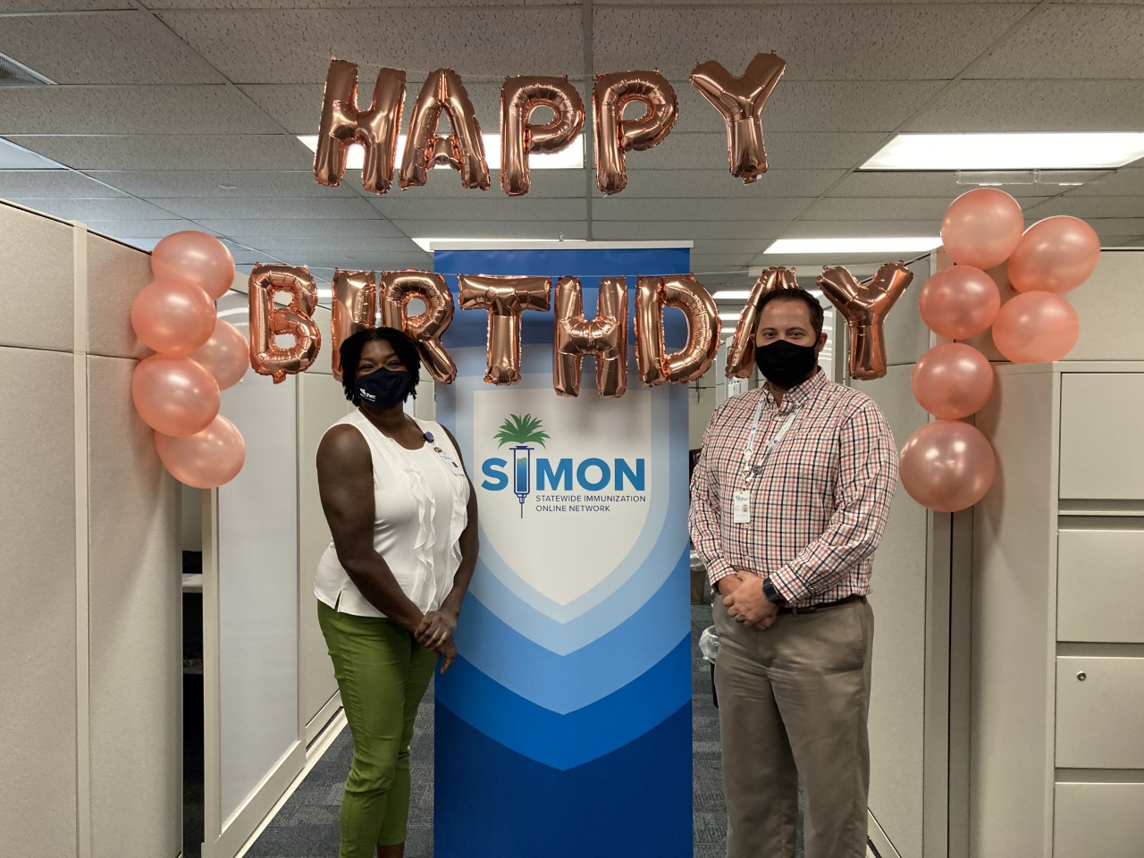
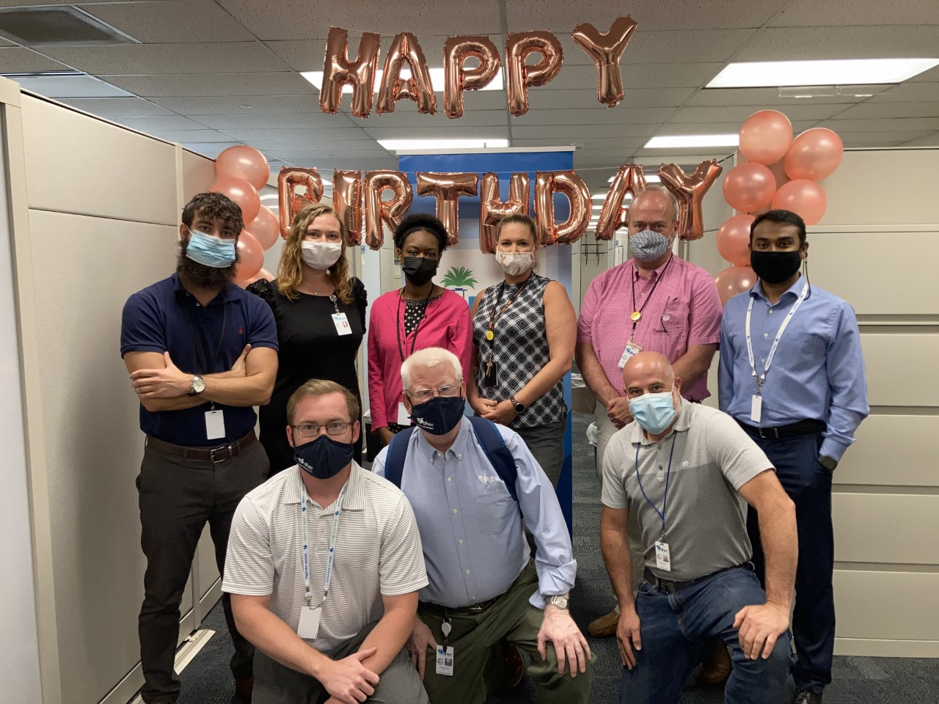
Clinical Team
Notes:
A couple more celebration pictures before we move on. On the left here we have a picture of our Immunizations Nurse Consultant, Tarcia Hill with our Division Director, Stephen White.
On the right is our VAMS and IIS teams who have taken on the lion’s share of the lift in this implementation.

Slide 12
SIMON Training Resources
www.scdhec.gov/SIMON
Notes:
Reminder of all our online training resources for SIMON.

Slide 13
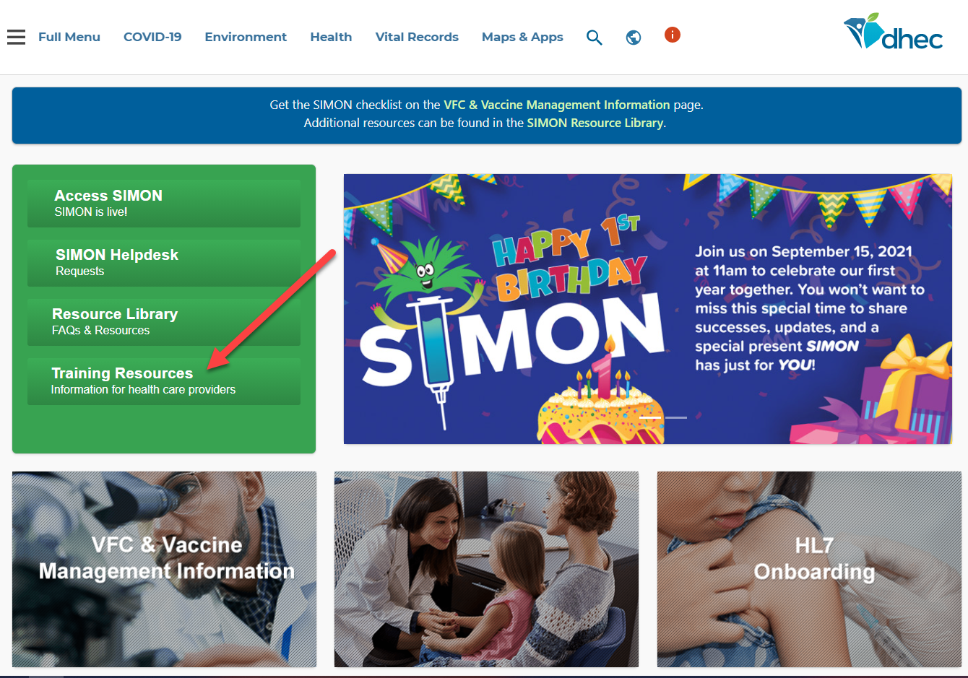
Information for Healthcare Providers
Notes:
On the home page of our SIMON Website we have a link to the many training resources available on demand/online.

Slide 14
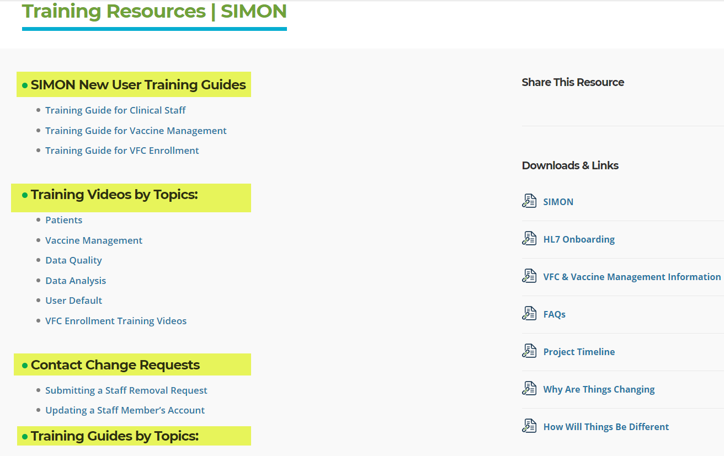
Training videos, printable guides and webinar recordings available on demand
Notes:
We have short training videos and printable guides available by topic, as well as webinar recordings with in-depth information on a variety of subjects.

Slide 15
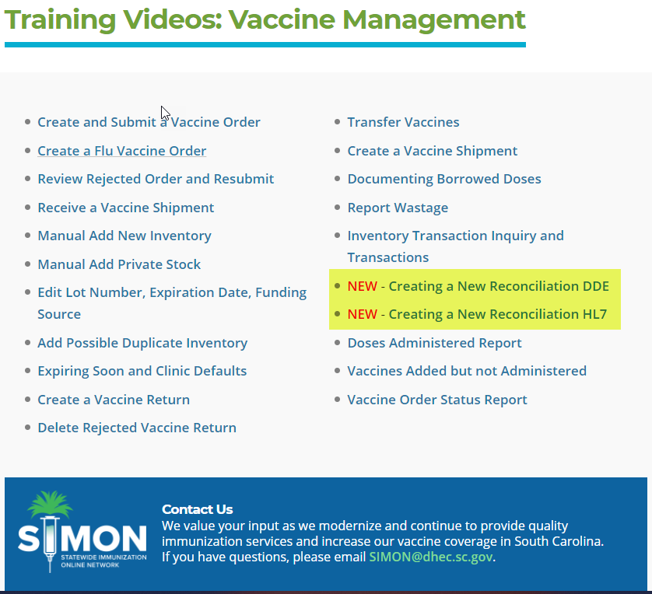
Information Updated when new features are released
Notes:
As new features are released the training videos and guides are updated and designated as new so you can readily access the latest information.

Slide 16
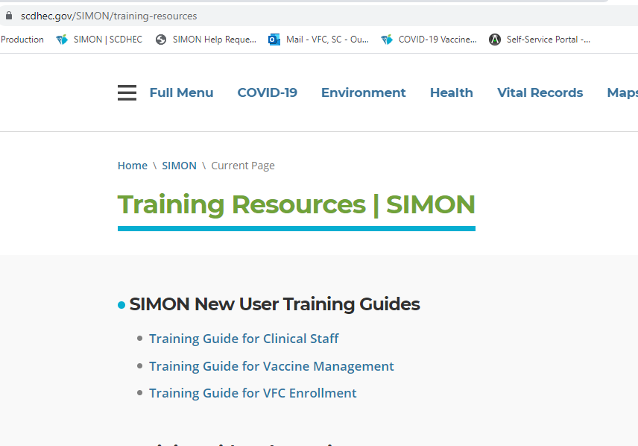
Training Guides for new SIMON Users, Primary and Back up Vaccine Coordinators and Providers
Notes:
For new users, we have training guides that will walk them through the SIMON processes, utilizing short videos and printable guides.

Slide 17

What would a Birthday be without Presents?
Notes:
What would a birthday be without presents? We have some for you.

Slide 18
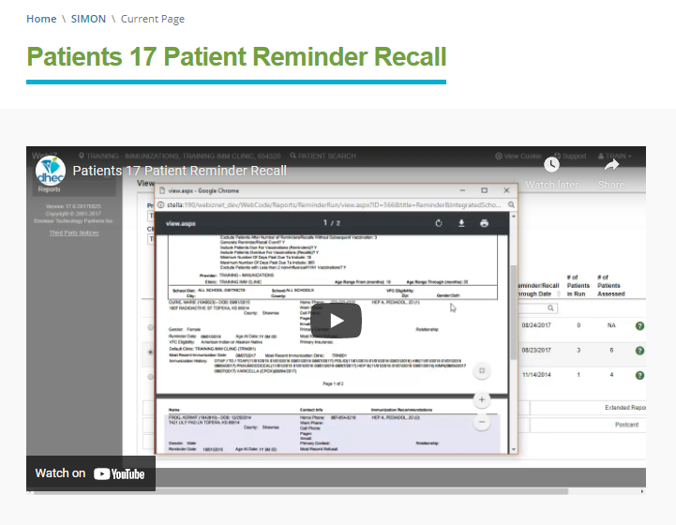
Reminder Recall Tool
https://scdhec.gov/SIMON/patients-17-patient-reminder-recall-simon
***Providers should check the patient’s medical record to make sure all the immunizations in the medical record are documented in the IIS***
Notes:
https://scdhec.gov/SIMON/patients-17-patient-reminder-recall-simon
Reminder Recall is one of the tools we are showcasing for SIMON’s birthday, and it’s a powerful one. Reminder Recall allows a provider to run reports based on timeframes, age groups, and vaccine series. The resulting report can help providers successfully outreach to patients based on certain parameters, and let them know it’s time to come in for a specific vaccination.
When using this tool, it’s important for providers to check the patient’s medical record to make sure all the immunization in the medical record are documented in the IIS. It is critical for accuracy (in multiple respects) that SC providers are making sure the immunizations given in their clinics have been imported or entered in the IIS.
I’ve linked the Reminder Recall tool in the slide and hope you all will check it out. The video is about 10 minutes long in total.

Slide 19
Temperature Excursion Online Report
All temperature excursions will be reported online via the online Temperature Excursion Document. (Coming Fall 2021)
Online interactive document will be located on the SIMON homepage
Training will be provided ( ex. step by step guide, educational video tutorial, and webinar presentation)
Once online system is live, a help desk request will no longer be needed to report a temperature excursion.
Failure Report for VFC/STATE providers in SIMON will still be required.
Notes:
*The Immunization Division is excited to announce that we are putting the final touches on the online temperature excursion tool for providers to report temperature excursions online. This will be an interactive document between the Immunization Staff and the provider.
*The goal for this interactive tool is to streamline the process for reporting a temperature excursion for a quicker turnaround from the initial report and the closing of the temperature report.
*The tool will look similar to the COVID-19 Temperature Excursion Tool that is available for the COVID 19 Providers. (VFC providers that are current COVID Providers will be able to report all vaccines (including COVID vaccines) to this one document instead of having to report the excursions like what is being done now.
*More information for this tool will be coming in a few weeks.

Slide 20
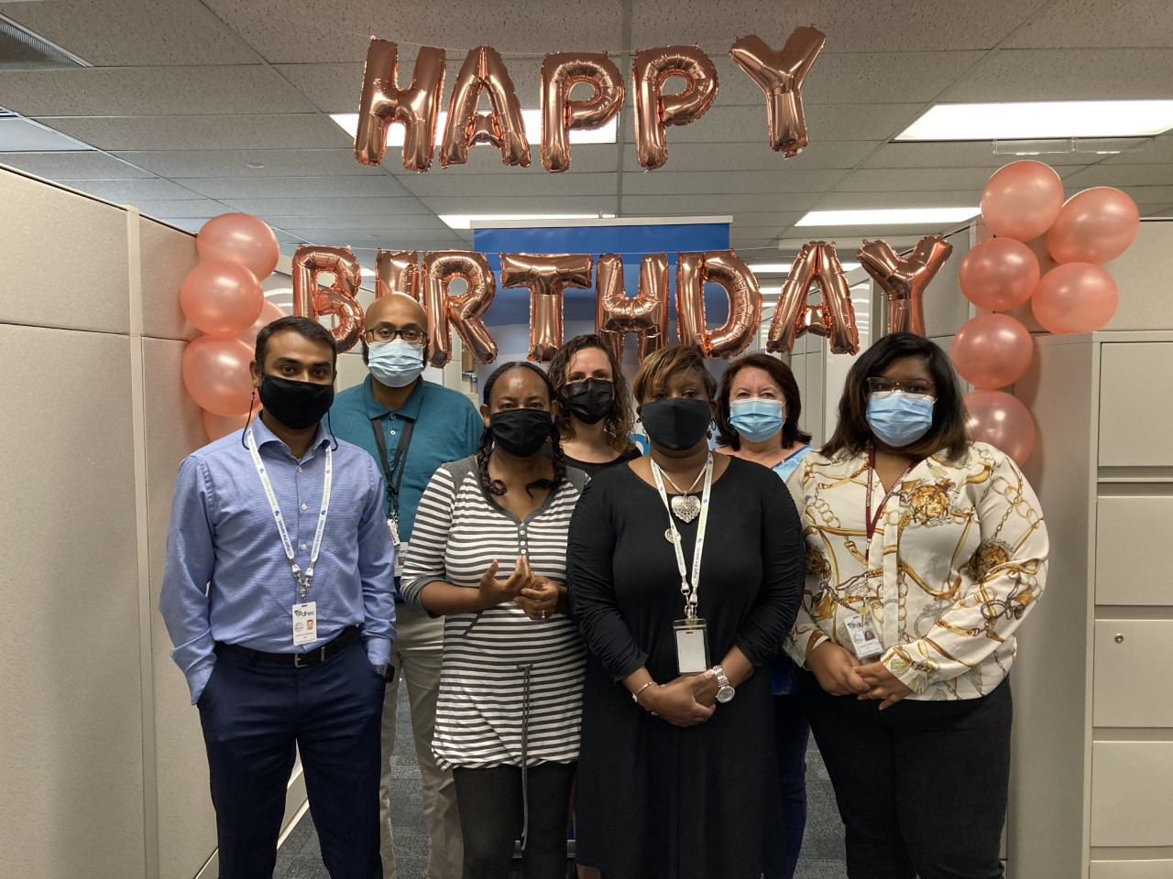
Vaccines for Children (VFC) Updates
Notes:
Here’s our Vaccines for Children staff celebrating SIMON’s birthday! VFC, like all aspects of our immunizations program, has benefitted from the implementation of SIMON. I would also like to share some other brief updates from VFC…..

Slide 21

VFC Website Updates
Notes:
We have a new website for the VFC program. In addition to being a streamlined hub for provider resources and information, this page has a very exciting feature which will soon go live.

Slide 22
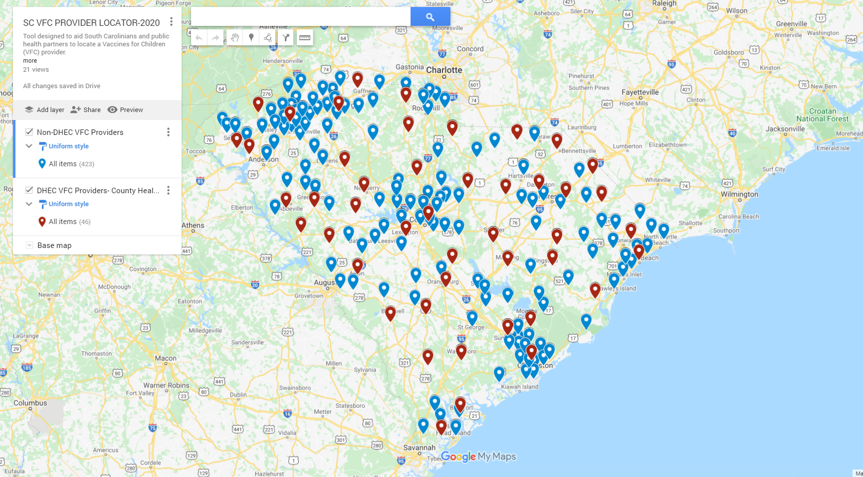
Find a Provider
Notes:
The “Find a Provider” function! This is a searchable, map-based program that will allow families to quickly and easily identify providers offering free and low-cost vaccines, at locations convenient to them.

Slide 23
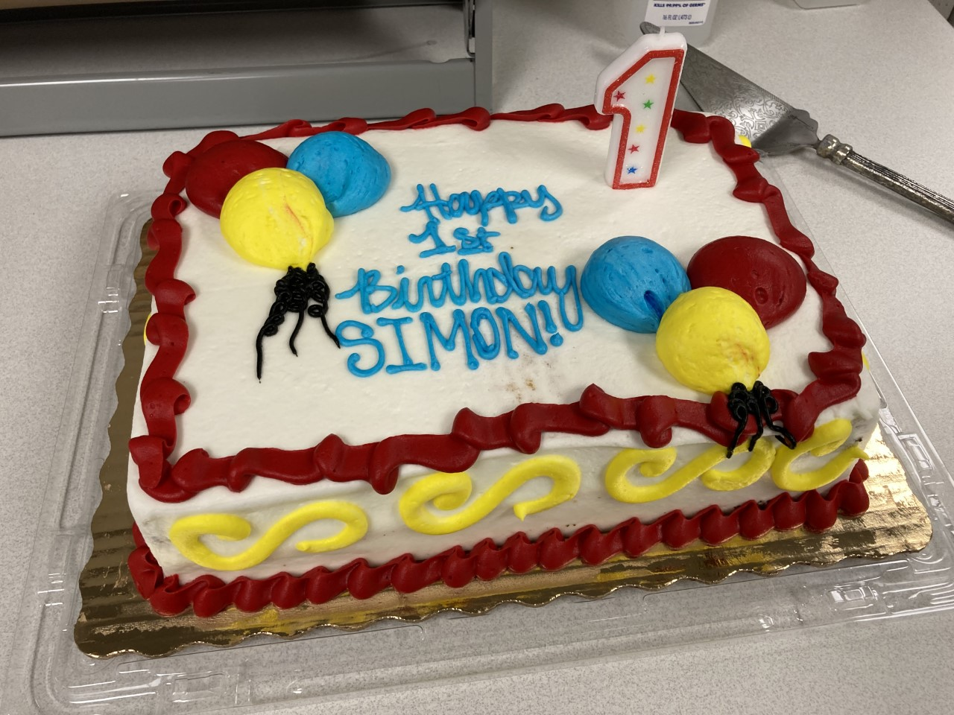

Comments/Questions
Notes:
If you have questions please post in the chat and we will answer as many as possible and those we don’t get to we will answer and post with the recording of this webinar on the SIMON Website.

Slide 24
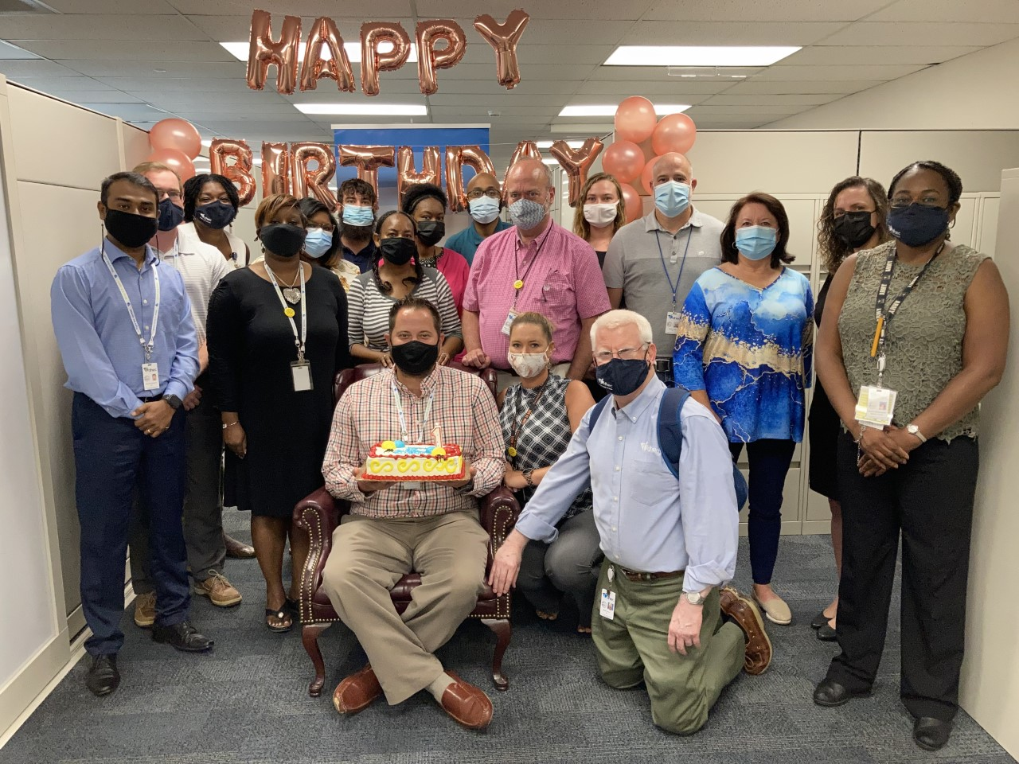
Notes:
Once again we want to thank you from the entire Immunizations Division. We appreciate you being here today, and we appreciate your partnership as we continue to innovate and advance immunization services in South Carolina.

Slide 25
DHEC Immunization Division
Immunize@dhec.sc.gov
803-898-0460

