Slide 1


SIMON Training for New Clinical Users
10.30.20

Slide 2
Part 1 – Patients and Vaccine Administration
Logging into SIMON
Set User defaults
Patient Search and updating demographics
Patient Allergies, Risks, Events and Notes
Adding Historic Doses
Add and Administer Doses
Document Adverse Reaction
Document a Vaccine Refusal
How to Print Personal Immunization Record
How to Print a Certificate of Immunization
SIMON Help Request

Slide 3
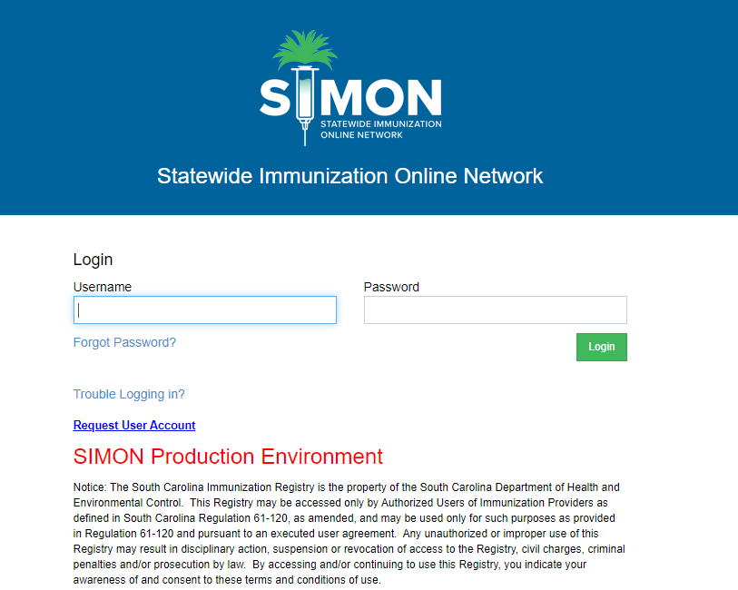
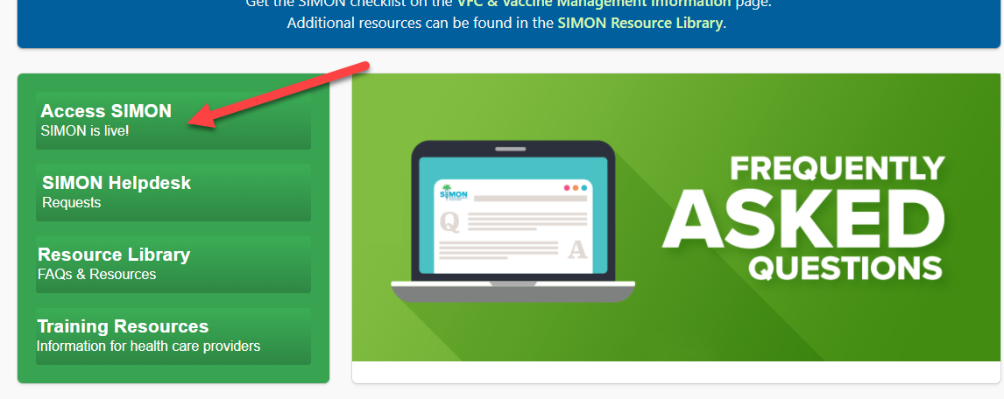
Logging into SIMON Production
1. Go to the SIMON website www.scdhec.gov/SIMON
Click the Access SIMON button
2. Log in with username and password you have been sent via encrypted email.

Slide 4
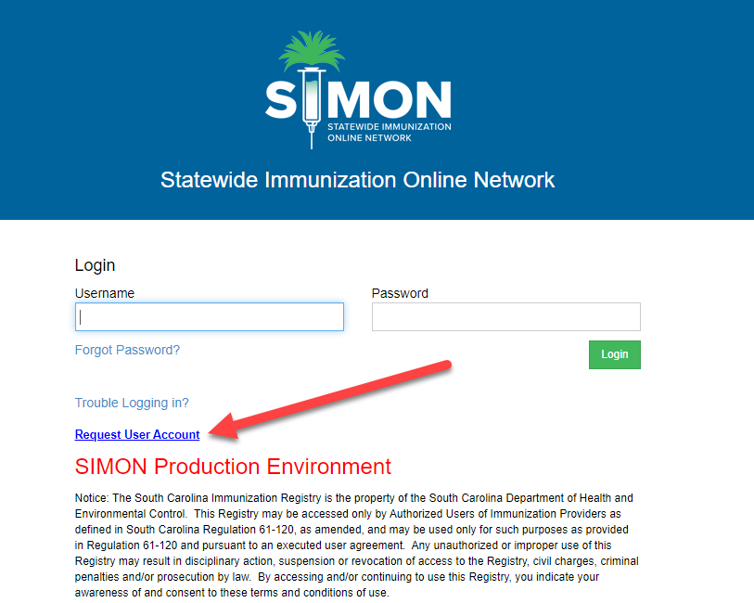
If you are a new user and need to request a SIMON account
Follow the previous steps and click Request User Account

Slide 5
User Defaults
Click the link to view the instructional video on User Defaults
https://www.scdhec.gov/default-01-set-user-defaults-simon

Slide 6
Patient Search and Updating Demographics
Click the links to view the instructional videos on Patient Search and Updating demographics
https://scdhec.gov/patients-01-search-existing-patient-simon
https://scdhec.gov/patients-02-add-new-patient-simon
https://scdhec.gov/patients-03-patient-programs-simon
Link to guide
https://www.scdhec.gov/sites/default/files/media/document/02PatientDemographics_FINAL.pdf

Slide 7
Documenting Patient Allergies, Risks, Events and Notes
Click the link to view the instructional video on Documenting Patient Allergies, Risks, Events and Notes
https://www.scdhec.gov/patients-05-patient-allergies-risks-events-and-notes-simon

Slide 8
Add Historic Doses
Click the links to view the instructional videos on Adding Historic Doses:
https://www.scdhec.gov/patients-06-add-historic-doses-checkboxes-simon
https://www.scdhec.gov/patients-07-add-historic-doses-date-boxes-simon
Link to Guide
https://www.scdhec.gov/sites/default/files/media/document/03AddHistoryFromPaperRecord_FINAL.pdf

Slide 9
Adding and Administering Vaccinations
Click the link to view the instructional video on Adding and Administering Vaccinations
https://www.scdhec.gov/patients-09-add-and-administered-doses-simon
Link to Guide
https://www.scdhec.gov/sites/default/files/media/document/05Add%20Vaccines%20Type%203_FINAL.pdf

Slide 10
Document Adverse Reaction
Click on the link to view instructional video on documenting an Adverse Reaction to a vaccine
https://www.scdhec.gov/patients-12-document-adverse-reaction-simon

Slide 11
Documenting a Vaccine Refusal
Click the link to view the instructional video on Documenting a Vaccine Refusal:
https://www.scdhec.gov/patients-11-record-vaccine-refusal-simon

Slide 12
How to Print Personal Immunization Record
Click on link to open guide on how to Print a Personal Immunization Record
https://www.scdhec.gov/sites/default/files/media/document/06Print%20IZ%20Record_FINAL.pdf

Slide 13
How to Print a Certificate of Immunization
Click the link to view the guide on Printing a Certificate of Immunization
https://www.scdhec.gov/sites/default/files/media/document/07Print%20Certificate%20of%20Immunization_FINAL.pdf

Slide 14
Part 2 – Vaccine Management
Manage Assets – storage units, thermometers and temperature recording
Add inventory
Create and submit vaccine returns
Reconciliation Process
Staff contact add and changes
Create and Submit a Vaccine order
Receive VTrcks Shipment
Create and Submit Vaccine Return

Slide 15
Manage assets – Storage Units, Thermometers and Temperature Recording
Click the link to view instructional video on Storage Units, Thermometers, and Temperature Recording
https://scdhec.gov/SIMON/storage-units-temps
Click on links below for guides
https://www.scdhec.gov/sites/default/files/media/document/01%20Create%20Storage%20Unit_FINAL.pdf
https://www.scdhec.gov/sites/default/files/media/document/02%20Create%20Thermometer%20and%20Link%20Unit_FINAL.pdf
https://www.scdhec.gov/sites/default/files/media/document/04%20Record%20Temperature%20Readings%20%28CTM%29_FINAL.pdf

Slide 16
Adding Vaccine Inventory
Click on link to view instructional video for Adding Vaccine Inventory
https://www.scdhec.gov/vax-mgt-05-manual-add-new-inventory
Click link below to view guide
https://www.scdhec.gov/sites/default/files/media/document/05%20Onhand%20Add%20New%20Inventory_FINAL.pdf

Slide 17
Create and Submit Vaccine Returns
Click on link to view instructional video on Submitting a Vaccine Return
https://www.scdhec.gov/vax-mgt-10-create-vaccine-return-simon
Click on link below for guide
https://www.scdhec.gov/sites/default/files/media/document/08%20Create%20and%20Submit%20a%20Vaccine%20Return_FINAL.pdf

Slide 18
Inventory Reconciliation Process
Click the link to view the instructional video on the Inventory Reconciliation Process
https://www.scdhec.gov/vax-mgt-17-reconciliation-simon
Click the links below for guide and checklist
https://scdhec.gov/sites/default/files/media/document/09_Reconciliation_Direct_Entry_FINAL_%28003%29.pdf
https://scdhec.gov/sites/default/files/media/document/SIMON-Manual_Vaccine_Inventory_Reconciliation_Checklist.pdf

Slide 19
Staff Contact Add and Change
Click the links below for guides to Adding and Changing Staff
https://dhec.sharepoint.com/:w:/r/sites/simoninternaltrainingdevelopment/Shared%20Documents/MySCLearning%20Courses/VFC%20Enrollment%20Courses/Add%20Staff%20guide_10.01.20.docx?d=wb6f358fea5c641bd9179e4c3b17daba7&csf=1&web=1&e=BjdbCV
https://www.scdhec.gov/sites/default/files/media/document/11%20Submit%20Staff%20Change%20Request_FINAL.pdf

Slide 20
Create and Submit a Vaccine Order
Click on the link to view the instructional video for Creating and submitting a Vaccine Order
https://www.scdhec.gov/vax-mgt-01-create-and-submit-vaccine-order-simon
Click on the link below for the guide
https://www.scdhec.gov/sites/default/files/media/document/12%20Create%20and%20Submit%20a%20Vaccine%20Order_FINAL.pdf

Slide 21
Receive a VTrcks Shipment
Click on the link to view the instructional video for Receiving a VTrcks Shipment
https://www.scdhec.gov/vax-mgt-04-receive-vaccine-shipment-simon
Click on the link below for the Guide
https://www.scdhec.gov/sites/default/files/media/document/13%20Receive%20VTrcks%20Shipment_FINAL.pdf

Slide 22
Create and Submit a Vaccine Return
Click on the link to view the instructional video on Creating and Submitting a Vaccine Return
https://www.scdhec.gov/vax-mgt-10-create-vaccine-return-simon
Click on the link below for the Guide
https://www.scdhec.gov/sites/default/files/media/document/08%20Create%20and%20Submit%20a%20Vaccine%20Return_FINAL.pdf

Slide 23
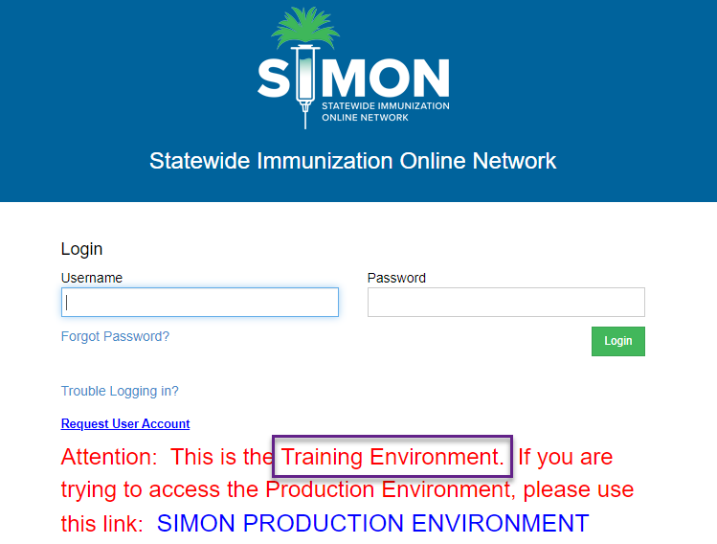
Logging into SIMON Training
You may better prepare yourself for using SIMON by going to the SIMON Training website and practicing what you just saw in the videos.​
https://simon-training.dhec.sc.gov/simon_training/Login.aspx​

Slide 24
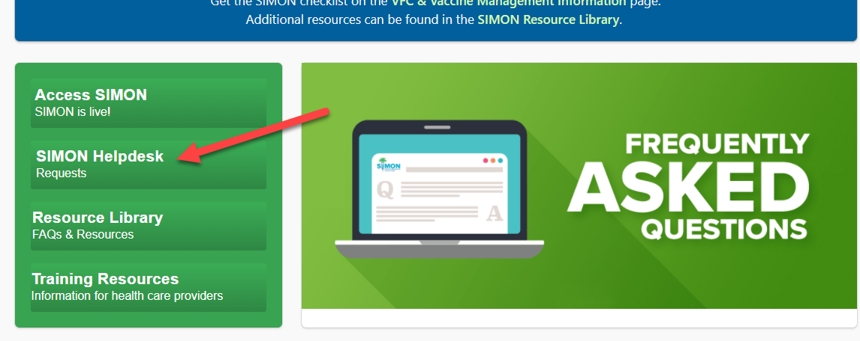
SIMON Helpdesk Request
To submit a Help Request for issues with SIMON go to the SIMON website at www.scdhec.gov/SIMON and click on the
SIMON Helpdesk button

