Slide 1


SIMON VFC Enrollment Training for the New User
11.05.20

Slide 2
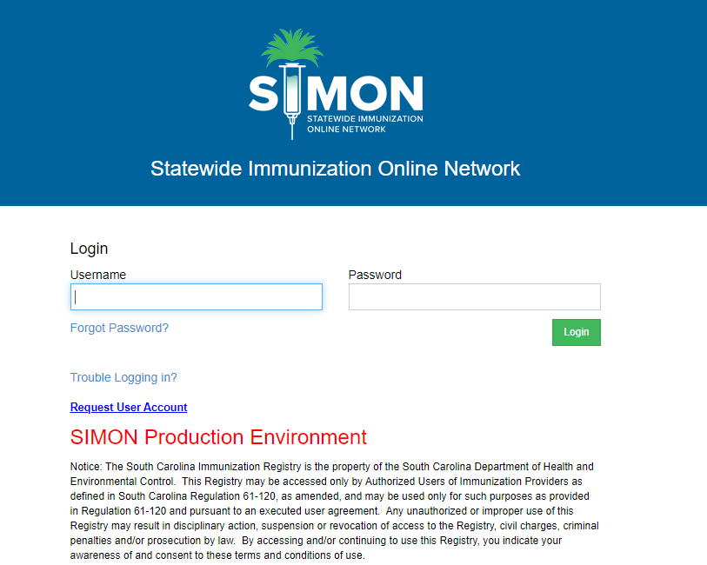
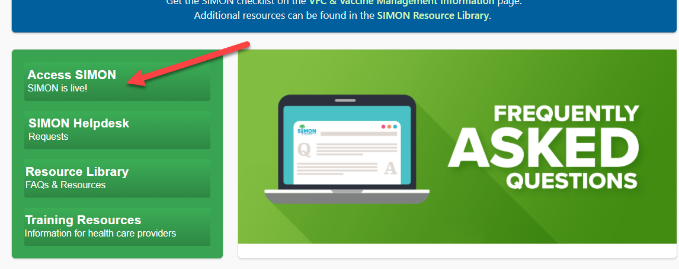
Logging into SIMON Production
1. Go to the SIMON website www.scdhec.gov/SIMON
Click the Access SIMON button
2. Log in with username and password you have been sent via encrypted email.

Slide 3
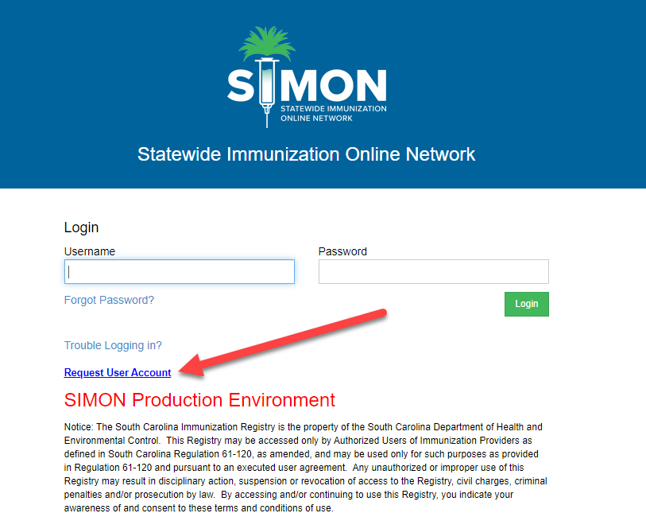
If you are a new user and need to request a SIMON account
Follow the previous steps and click Request User Account

Slide 4
User Defaults
Click the link to view the instructional video on User Defaults
https://www.scdhec.gov/default-01-set-user-defaults-simon

Slide 5
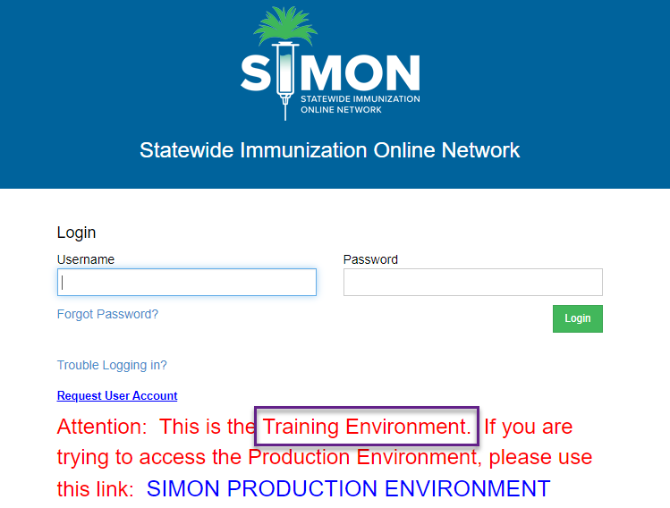
Logging into SIMON Training
You may better prepare yourself for using SIMON by going to the SIMON Training website and practicing what you just saw in the videos.​
https://simon-training.dhec.sc.gov/simon_training/Login.aspx​

Slide 6
VFC Enrollment Overview
Click the link below to access the instructional VFE Enrollment Overview
https://www.scdhec.gov/SIMON/enrollments-overvew

Slide 7
Storage Units and Temperature Logging
Click the link below to view the instructional video on entering Storage Units and Temperature Logging
https://scdhec.gov/SIMON/storage-units-temps

Slide 8
Enrollment Checklist and Staff Review
Click on the link below to view the instructional video on the VFC Enrollment Checklist and Staff Review
https://scdhec.gov/SIMON/checklist-reviewing-staff
Click on link for VFC Coordinator Roles and Responsibilities
https://scdhec.gov/sites/default/files/media/document/VFC-Coord-roles-responsibilities_8.20.pdf

Slide 9
Provider Clinic Profile
Click on the link below to view the instructional video on the Provider Clinic Profile
https://scdhec.gov/provider-clinic-profile

Slide 10
Provider Clinic Agreement
Click on the link below to view the video on the VFC Provider Clinic Agreement
https://scdhec.gov/SIMON/provider-clinic-agreement

Slide 11
Resubmitting a Rejected VFC Enrollment
Click on the link below to view the video on How to Resubmit a Rejected VFC Enrollment
https://scdhec.gov/SIMON/resubmit-rejected-enrollment

Slide 12
All VFC Providers must complete the South Carolina Routine and Emergency Vaccine Management Plan
Click the link below to access the SC Routine & Emergency Vaccine Management Plan Worksheet
https://scdhec.gov/sites/default/files/media/document/Final__SCREVMP_9.2020.pdf

Slide 13
CDC Training - You Call the Shots
The Primary and Back-up VFC Coordinators must complete two CDC You Call the Shots training modules annually: Vaccine Storage and Handling and Vaccines for Children.
It is strongly recommended that the Provider Agreement Signatory also complete these trainings.
A Certificate of Completion must be uploaded into SIMON as proof the annual training has been completed.
The modules can be accessed at: https://www.cdc.gov/vaccines/ed/youcalltheshots.html

Slide 14
20-21 VFC Provider Handbook
Click on the link below to access the 20-21 VFC Provider Handbook
https://scdhec.gov/sites/default/files/media/document/2020-2021-VFC-Provider-Handbook-9.14.2020.pdf

Slide 15
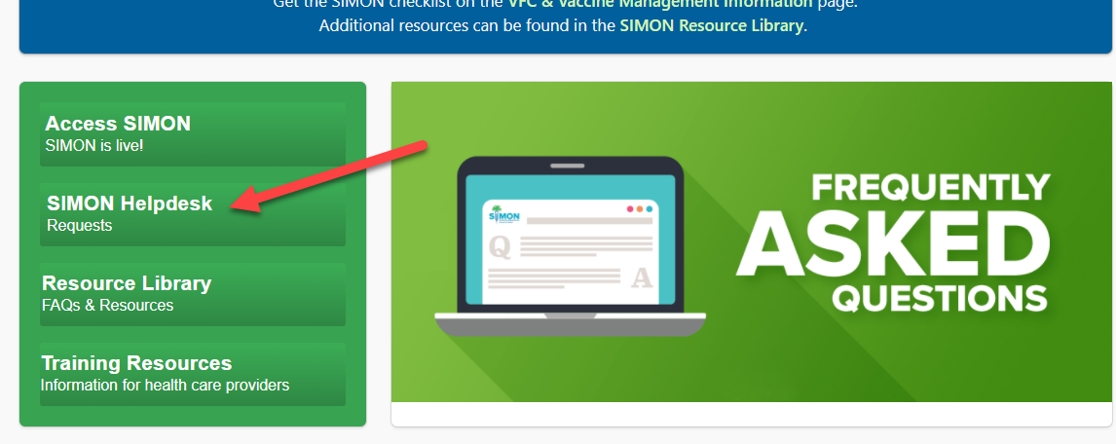
SIMON Helpdesk Request
To submit a Help Request for issues with SIMON go to the SIMON website at www.scdhec.gov/SIMON and click on the
SIMON Helpdesk button

