Slide 1


SIMON Vaccine Management Training for the New User
11.04.20

Slide 2
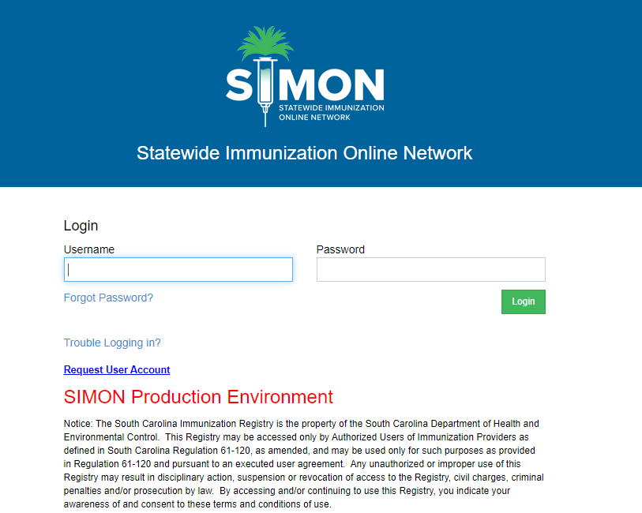
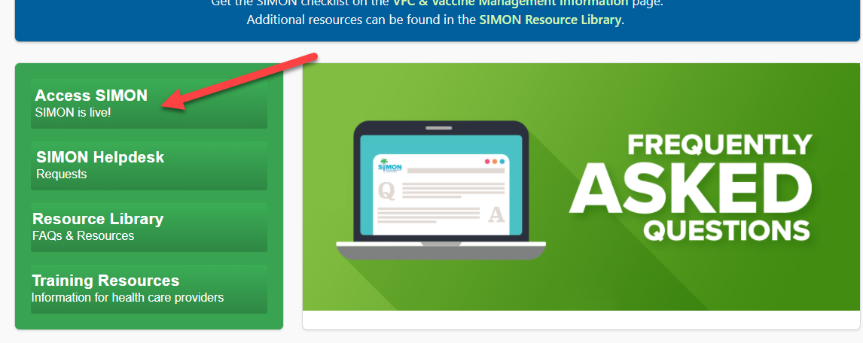
Logging into SIMON Production
1. Go to the SIMON website www.scdhec.gov/SIMON
Click the Access SIMON button
2. Log in with username and password you have been sent via encrypted email.

Slide 3
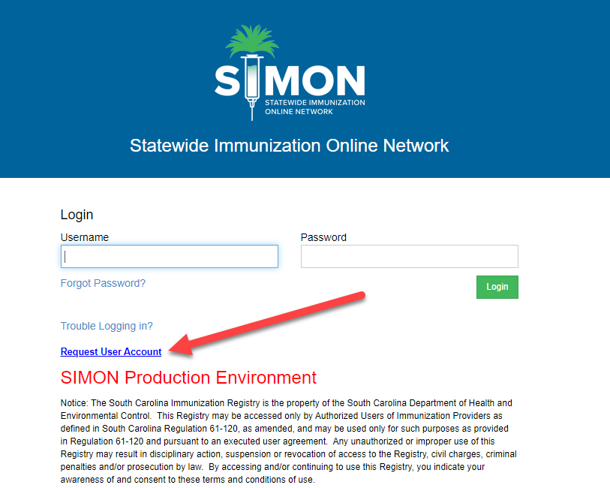
If you are a new user and need to request a SIMON account
Follow the previous steps and click Request User Account

Slide 4
User Defaults
Click the link to view the instructional video on User Defaults
https://www.scdhec.gov/default-01-set-user-defaults-simon

Slide 5
Part 2 – Vaccine Management
Manage Assets – storage units, thermometers and temperature recording
Add inventory
Create and submit vaccine returns
Reconciliation Process
Staff contact add and changes
Create and Submit a Vaccine order
Receive VTrcks Shipment
Create and Submit Vaccine Return
SIMON Training Environment
CDC – You Call the Shots

Slide 6
Manage assets – Storage Units, Thermometers and Temperature Recording
Click the link to view instructional video on Storage Units, Thermometers, and Temperature Recording
https://scdhec.gov/SIMON/storage-units-temps
Click on links below for guides
https://www.scdhec.gov/sites/default/files/media/document/01%20Create%20Storage%20Unit_FINAL.pdf
https://www.scdhec.gov/sites/default/files/media/document/02%20Create%20Thermometer%20and%20Link%20Unit_FINAL.pdf
https://www.scdhec.gov/sites/default/files/media/document/04%20Record%20Temperature%20Readings%20%28CTM%29_FINAL.pdf

Slide 7
Adding Vaccine Inventory
Click on link to view instructional video for Adding Vaccine Inventory
https://www.scdhec.gov/vax-mgt-05-manual-add-new-inventory
Click link below to view guide
https://www.scdhec.gov/sites/default/files/media/document/05%20Onhand%20Add%20New%20Inventory_FINAL.pdf

Slide 8
Create and Submit Vaccine Returns
Click on link to view instructional video on Submitting a Vaccine Return
https://www.scdhec.gov/vax-mgt-10-create-vaccine-return-simon
Click on link below for guide
https://www.scdhec.gov/sites/default/files/media/document/08%20Create%20and%20Submit%20a%20Vaccine%20Return_FINAL.pdf

Slide 9
Inventory Reconciliation Process
Click the link to view the instructional video on the Inventory Reconciliation Process
(if you are a direct data entry site, choose the first link, if you are an HL7 site choose the second link)
https://scdhec.gov/SIMON/webinar-creating-new-reconciliation-dde
https://scdhec.gov/SIMON/webinar-creating-new-reconciliation-hl7
Click the links below for guide and checklist
https://scdhec.gov/sites/default/files/media/document/09_Reconciliation_Direct_Entry_FINAL_%28003%29.pdf
https://scdhec.gov/sites/default/files/media/document/SIMON-Manual_Vaccine_Inventory_Reconciliation_Checklist.pdf

Slide 10
Staff Contact Add and Change
Click the links below for guides to Adding and Changing Staff
https://dhec.sharepoint.com/:w:/r/sites/simoninternaltrainingdevelopment/Shared%20Documents/MySCLearning%20Courses/VFC%20Enrollment%20Courses/Add%20Staff%20guide_10.01.20.docx?d=wb6f358fea5c641bd9179e4c3b17daba7&csf=1&web=1&e=BjdbCV
https://www.scdhec.gov/sites/default/files/media/document/11%20Submit%20Staff%20Change%20Request_FINAL.pdf

Slide 11
Create and Submit a Vaccine Order
Click on the link to view the instructional video for Creating and submitting a Vaccine Order
https://www.scdhec.gov/vax-mgt-01-create-and-submit-vaccine-order-simon
Click on the link below for the guide
https://www.scdhec.gov/sites/default/files/media/document/12%20Create%20and%20Submit%20a%20Vaccine%20Order_FINAL.pdf

Slide 12
Receive a VTrcks Shipment
Click on the link to view the instructional video for Receiving a VTrcks Shipment
https://www.scdhec.gov/vax-mgt-04-receive-vaccine-shipment-simon
Click on the link below for the Guide
https://www.scdhec.gov/sites/default/files/media/document/13%20Receive%20VTrcks%20Shipment_FINAL.pdf

Slide 13
Create and Submit a Vaccine Return
Click on the link to view the instructional video on Creating and Submitting a Vaccine Return
https://www.scdhec.gov/vax-mgt-10-create-vaccine-return-simon
Click on the link below for the Guide
https://www.scdhec.gov/sites/default/files/media/document/08%20Create%20and%20Submit%20a%20Vaccine%20Return_FINAL.pdf

Slide 14
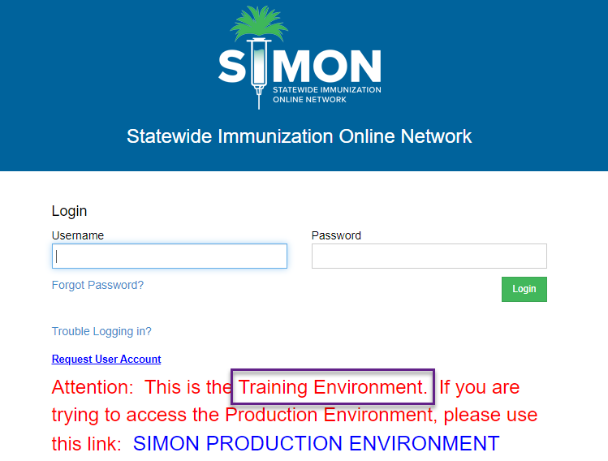
Logging into SIMON Training
You may better prepare yourself for using SIMON by going to the SIMON Training website and practicing what you just saw in the videos.​
https://simon-training.dhec.sc.gov/simon_training/Login.aspx​

Slide 15
All VFC Providers must complete the South Carolina Routine and Emergency Vaccine Management Plan
Click the link below to access the SC Routine & Emergency Vaccine Management Plan Worksheet
https://scdhec.gov/sites/default/files/media/document/Final__SCREVMP_9.2020.pdf

Slide 16
CDC Training - You Call the Shots
The Primary and Back-up VFC Coordinators must complete two CDC You Call the Shots training modules annually: Vaccine Storage and Handling and Vaccines for Children.
It is strongly recommended that the Provider Agreement Signatory also complete these trainings.
A Certificate of Completion must be uploaded into SIMON as proof the annual training has been completed.
The modules can be accessed at: https://www.cdc.gov/vaccines/ed/youcalltheshots.html

Slide 17
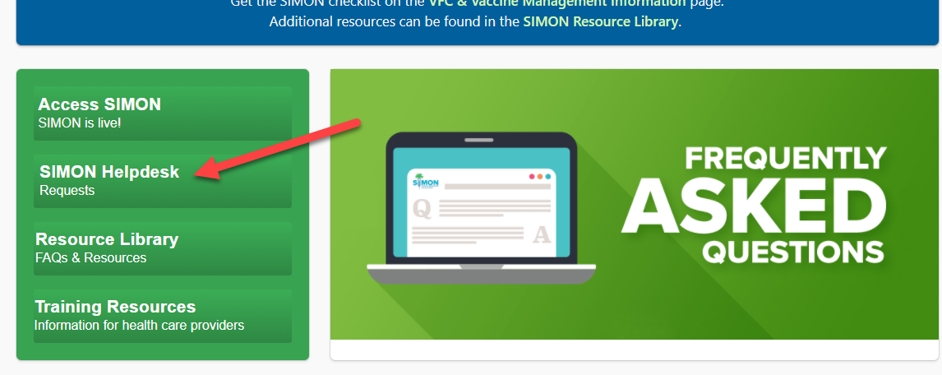
SIMON Helpdesk Request
To submit a Help Request for issues with SIMON go to the SIMON website at www.scdhec.gov/SIMON and click on the
SIMON Helpdesk button

