Slide 1

Sexual Health
PrEP Counseling Center

Slide 2
What is Sexual Health?
The CDC defines sexual health as:
  a state of physical emotional, mental and social well-being in relation to sexuality.
Sexual health requires a positive and respectful approach to sexuality and sexual relationships, as well as the possibility of having pleasurable and safe sexual experiences that are free of coercion, discrimination and violence.
Notes:
Sexual health- your desires, gender identity, and ability to give and receive pleasure freely

Slide 3
Sexual Health is Universal
Sex is a natural human act.
Everyone engaging in sexual activity or planning to engage in sexual activity should have a sexual health plan.
A sexual health plan is a physical and mental journey one has for engaging in healthy sexual relationships, preventing STIs and HIV, and planning pregnancies.

Slide 4
Reproductive Health
Reproductive health includes sexual health.
This refers to the ability to have children.
World Health Organizations (WHO) defines reproductive health as:
  "...state of complete physical, mental and social well-being and not merely the absence of disease or infirmity, in all matters relating to the reproductive system and to its functions and processes."

Slide 5
Family Planning
Pregnancy Prevention
  Birth control (implant, pills, rings, etc.)
  Condoms
  Abstinence
  Sterilization (tubal ligation or vasectomy)
Planned/Unplanned Pregnancy
  Consult your physician (medications and vaccinations)
  Make a plan (mental and physical stability)
  Adjust lifestyle and behaviors (avoid toxic substances such as drugs and alcohol)

Slide 6
LGBTQ+ Health
LGBTQ+ people are normal and exist within every community, but are at increased risk for several health threats when compared to their heterosexual peers.
LGBTQ+ people have the right to sexual health and sexual pleasure without the risk of disease, violence, and discrimination.
Education about other forms of sexual activities is important to reduce these risks.

Slide 7
Sexual Violence Prevention
Sexual violence is sexual activity without consent or freely given.
Sexual violence is common.
  Over half of women and almost 1 in 3 men will experience sexual violence in their lifetime.
Sexual violence starts early.
  1 in 3 female victims experience rape by age 11-17, and 1 in 8 experienced rape before the age of 10.
  1in 4 male victims experience rape by age 11-17 and 1 in 4 experienced rape before the age 10.
https://www.cdc.gov/violenceprevention/sexualviolence/fastfact.html

Slide 8
Sexually Transmitted Infections (STIs)
STIs are spread during unprotected sexual contact with someone who already has the infection.
STIs can be transmitted through oral, vaginal or anal sex.
STIs are common and affect almost EVERYONE!
Common STIs: chlamydia, gonorrhea, trichomoniasis, syphilis, genital warts (HPV), HIV, and genital herpes.

Slide 9
Sexually Transmitted Diseases
STIs greatly affect adolescents and people aged 15-24, so it’s important to begin practicing safer sexual health habits whenever you begin engaging in sexual activity.
Chlamydia, gonorrhea and syphilis cases have been rapidly rising with 2.5 million new cases in 2021.
Chlamydia, gonorrhea and syphilis increases one’s chance of getting HIV.

Slide 10
Take control of your SEXUAL HEALTH!
Talk about sex honestly with partner(s).
Engage in safe and pleasurable sex.
Take responsibility for your sexual safety.
Protect yourself and partner(s) from STIs.
  Use condoms. Talk to your doctor about DoxyPEP
  Get tested. The CDC recommends everyone get tested for HIV at least once a year. Those who are sexually active and/or have multiple partners should be tested for HIV and STIs every 3-6 months.
Get vaccinated (This includes HPV, HBV and mpox).

Slide 11
TAKE CONTROL
WRITE YOUR OWN STORY
Protect yourself
  Condoms (have your own supply!)
  PrEP, nPEP and doxyPEP
  Abstinence
  Routine STI and HIV testing
  Family planning
  Personal Risk Reduction Plan

Slide 12
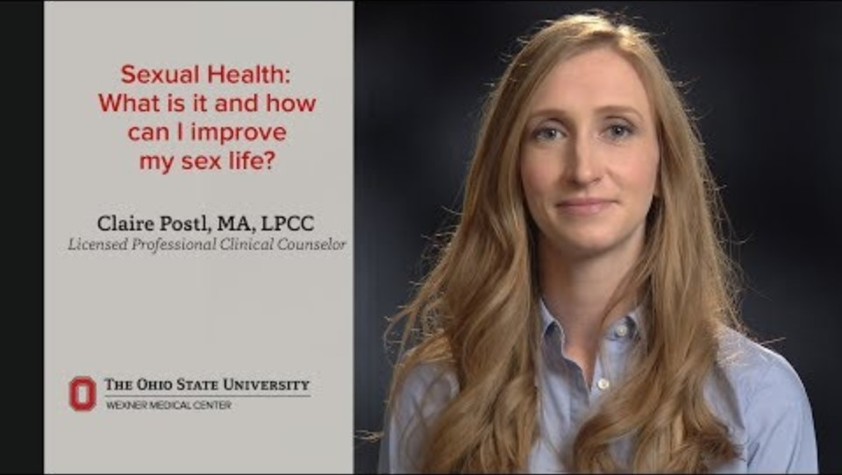
Tips to Improve Sex Life

Slide 13
References
Centers for Disease Control and Prevention (2022). Fast facts: Preventing sexual violence. https://www.cdc.gov/violenceprevention/sexualviolence/fastfact.html
Centers for Disease Control and Prevention [CDC], 2024, Sexual health, https://www.cdc.gov/sexualhealth/Default.html.
Mayo Clinic Staff, 2023, Sexual Health, https://www.mayoclinic.org/healthy-lifestyle/sexual-health/basics/sexual-health-basics/hlv-20049432.

Slide 14
Andre Jennings, DHA, HIV-PCP
PrEP Program Coordinator II
DHEC Central Office
Office: 803-898-8088
Cell: 803-973-1349
Email: jenninaj@dhec.sc.gov

