Slide 1

Prescription Monitoring Program
Bureau of Drug Control

Slide 2
Objectives:
Review proper record keeping requirements
Describe South Carolina’s Prescription Monitoring Program
Discuss how to report dispensations to the SC PMP
Review how to check patient prescription history through SC PMP

Slide 3
Legislation
Section 44-53-280(C) and (D) of the 1976 Code is amended to read:
D) All registrations other than class 20-28, as provided for by the board in regulation, expire on April first of each year. The registration of a registrant who fails to renew by April first is canceled. However, registration may be reinstated upon payment of the renewal fees due and a penalty of one hundred dollars if the registrant is otherwise in good standing and presents a satisfactory explanation for failure to renew.“
Please make sure to renew early. Providers are not authorized to prescribe, administer, possess or dispense controlled substances until their SC Controlled Substances Registration is reinstated.

Slide 4
Section 44-53-360 of the 1976 Code:
(1) A written prescription for any Schedule II, III, IV, and V controlled substance must be written on tamper-resistant prescription pads which contain one or more industry-recognized features designed to prevent all of the following:
(A) unauthorized copying of a completed or blank prescription form;
(B) erasure or modification of information written on the prescription by the prescriber; and
(C) use of counterfeit prescription forms.
(2) Prescription orders transmitted by facsimile, orally, or electronically are exempt from the tamper-resistant prescription pad requirements of this section.

Slide 5
Section 44-53-360 of the 1976 Code is amended:
(1) Initial opioid prescriptions for acute pain management or postoperative pain management must not exceed a seven-day supply, except when clinically indicated for cancer pain, chronic pain, hospice care, palliative care, major trauma, major surgery, treatment of sickle cell disease, treatment of neonatal abstinence syndrome, or medication-assisted treatment for substance use disorder. Upon any subsequent consultation for the same pain, the practitioner may issue any appropriate renewal, refill, or new opioid prescription.

Slide 6
Valid controlled substance prescriptions
SC 44-53-360. Prescriptions
(c) No controlled substances included in any schedule may be distributed or dispensed for other than a medical purpose. … No practitioner may dispense a controlled substance outside of a bona fide practitioner-patient relationship.

Slide 7
Dispensing by Practitioner
According to the SC Controlled Substance Regulation 61-4 section 506:
The act of dispensing controlled substances shall be performed by the registrant, and shall not be delegated to any person other than a pharmacist acting in the regular course of professional activity.

Slide 8
Bureau of Drug Control Record keeping requirements
Annual Inventory of all controlled substances on May 1
Controlled substance invoices must be kept separate or marked; CII separate from CIII-V; date received indicated
Dispensing log to record each dispensing or administration
Max of 31 day supply dispensed
Controlled substances should be stored in a securely locked and substantially constructed cabinet
Registrants should report any theft/loss to DHEC Bureau of Drug Control
All records must be readily retrievable and kept for 2 years

Slide 9
Controlled substance dispensing records must be kept separate from patient chart
Record must include the following information:
  Drug name and strength
  Date dispensed or administered
  Patient name and address
  Quantity dispensed or administered
  Dispenser’s signature or initials
  Practitioner’s initials
  Must report dispensations to SC Prescription Monitoring Program

Slide 10
REMINDERS
Keep all prescription blanks in a secure place
Power of attorney
Documentation of all authorized controlled substance prescriptions in patient’s medical record

Slide 11
Common Diversion in Veterinary Practices
Stealing controlled substances from office stock
Ordering drugs for personal use and discard invoice
Telephoning /writing false prescriptions
Stealing or selling prescription blanks
Break-ins

Slide 12
Theft/Loss
Reg section 404 (c)
(c) The registrant shall notify the office of the Bureau of Drug Control of any theft or loss of any controlled substances upon discovery of such theft or loss. The supplier shall be responsible for reporting in-transit losses of controlled substances by the contract or common carrier pursuant to subparagraph (e) of this section, upon discovery of such theft or loss. The registrant shall also complete DEA Form 106 regarding such theft or loss. Thefts shall be reported whether or not the controlled substances are subsequently recovered and/or the responsible parties are identified and action taken against them.
408. Filing of Theft Reports.
Theft reports (DEA Form 106) as required by this regulation shall be filed with the Bureau of Drug Control not later than 30 days following the discovery of the theft. Failure to file theft reports within the thirty-day period shall result in the issuance of an order to show cause for revocation or suspension of registration under the Act.

Slide 13
WHAT IS SCRIPTS?
C II- CIV prescriptions dispensed in SC are uploaded daily by the dispensing pharmacy/practitioner to Appriss (our vendor).
An authorized user (practitioner/pharmacist/delegate) logs into the SCRIPTS database and queries their patient.
The practitioner/pharmacist uses the SCRIPTS report to make informed healthcare decisions. The user will verify any data on the report, if necessary.
PMP Clearinghouse is for submitting dispensations to the SC PMP.
PMP Aware is for checking SCRIPTS for patient prescription history.

Slide 14
New patient encounter
Must have a patient-practitioner relationship
H3824 South Carolina General Assembly signed May 19, 2017
“Section 44‑53‑1645. (A) A practitioner, or the practitioner’s authorized delegate, shall review a patient’s controlled substance prescription history, as maintained in the prescription monitoring program, before the practitioner issues a prescription for a Schedule II controlled substance.
(B) The requirements of this section do not apply to:
(2) a practitioner issuing a prescription for a Schedule II controlled substance that does not exceed a five‑day supply for a patient;

Slide 15
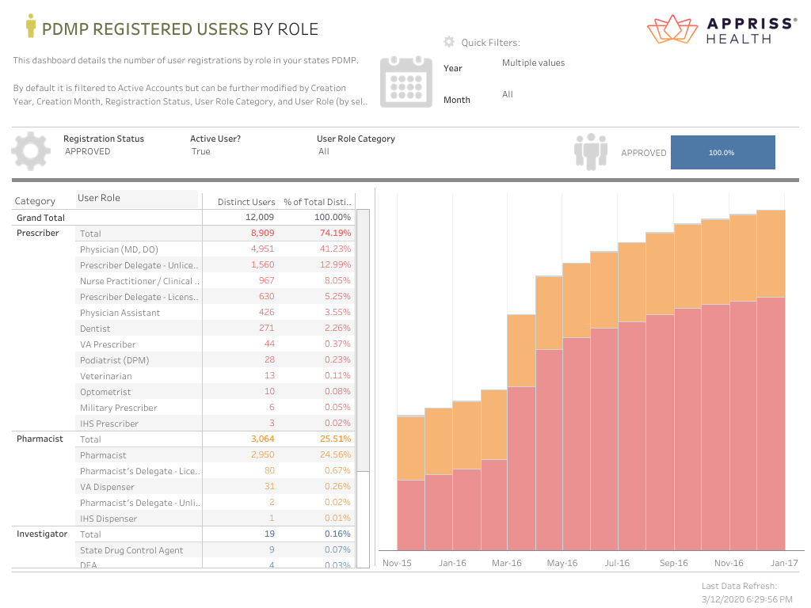
2015-2016

Slide 16
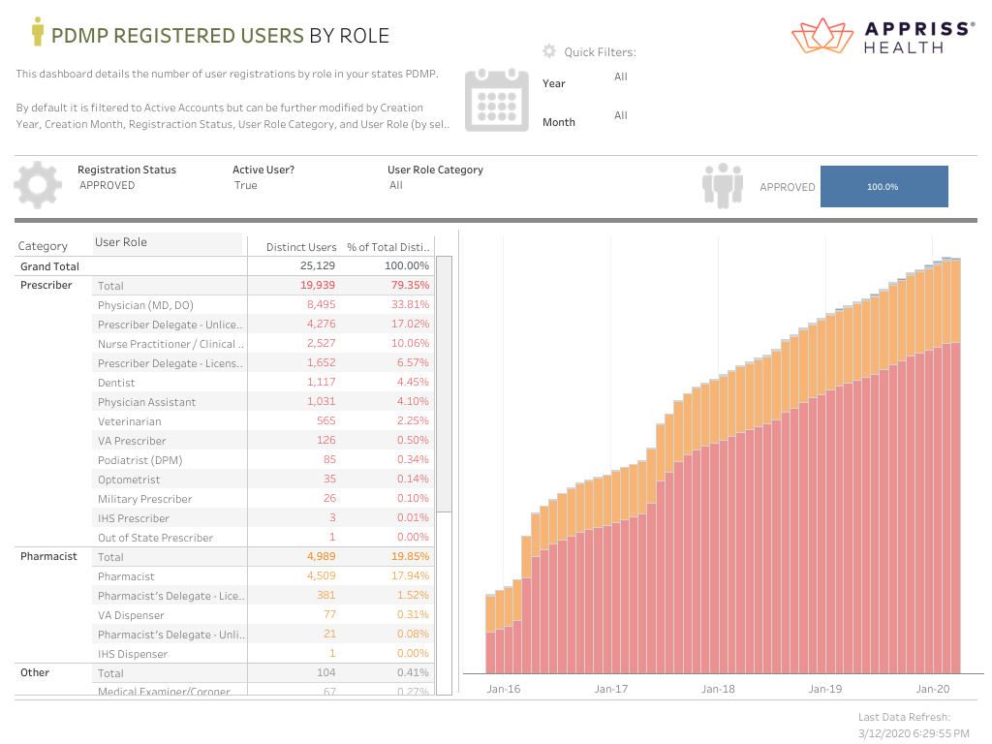

Slide 17
DELEGATES
Limit of 3 delegates per provider
Delegates may be licensed or unlicensed
Delegate may be delegate for unlimited number of providers
Supervisor is responsible for reports that delegate runs
Remember to deactivate them when they are no longer needed or leave your employment!

Slide 18
PMP Aware - To check SCRIPTS
https://southcarolina.pmpaware.net/

Slide 19
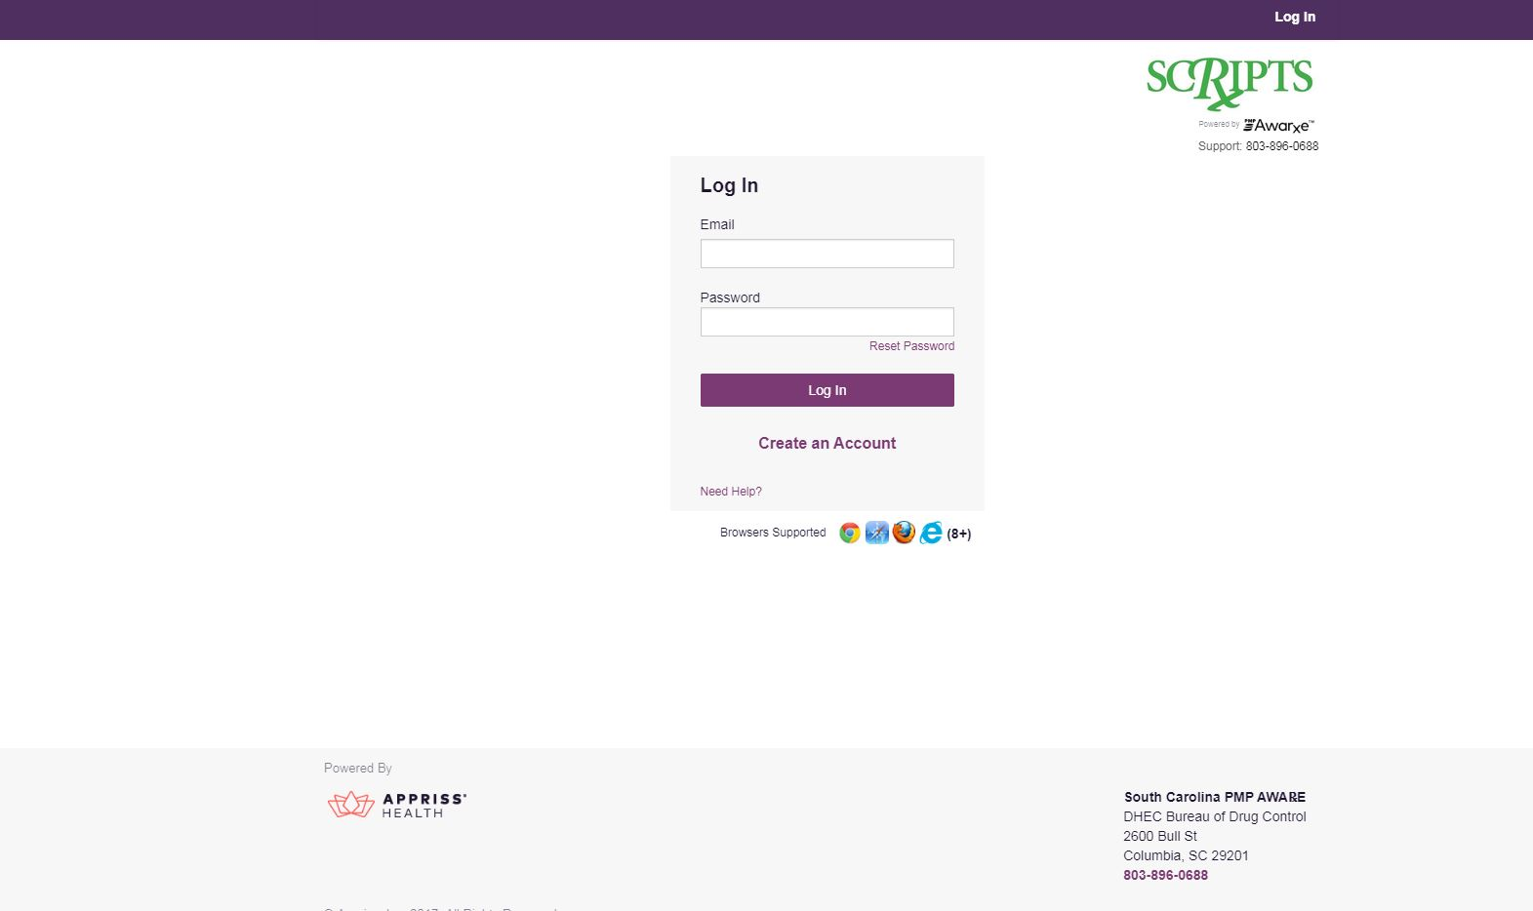

Slide 20
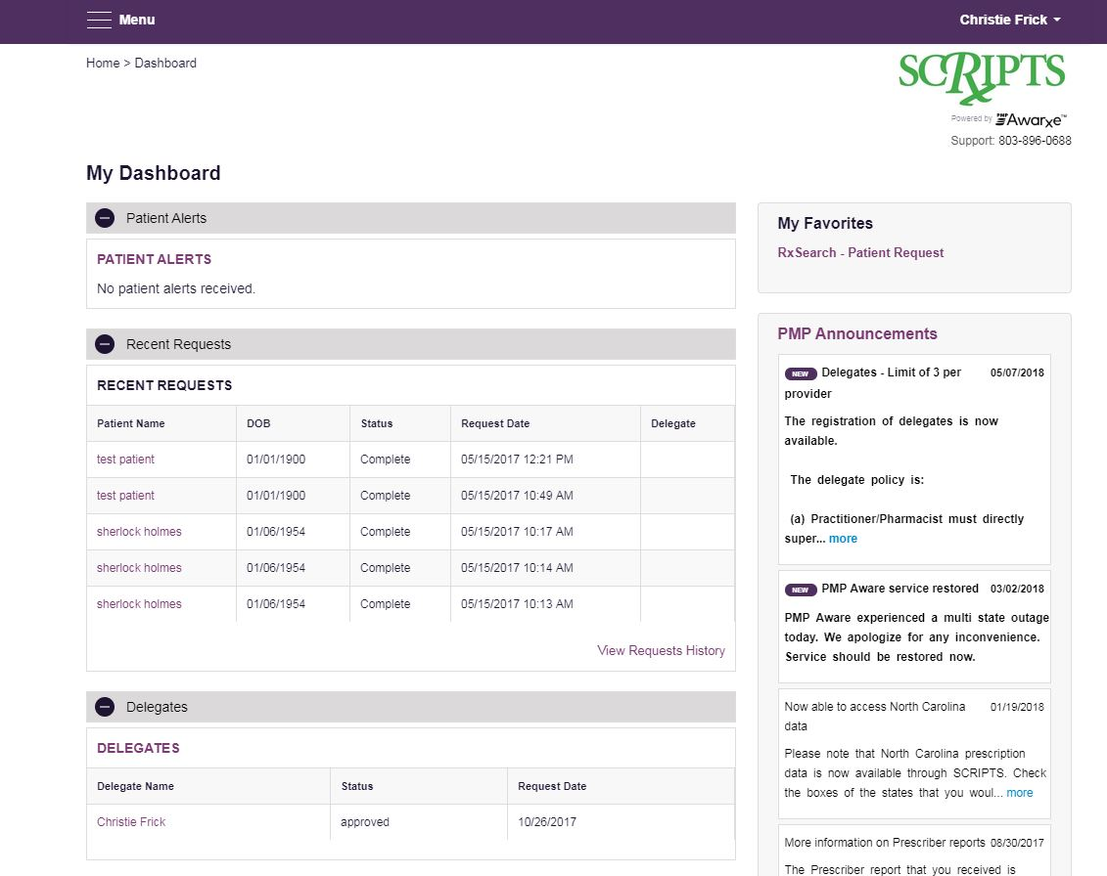

Slide 21
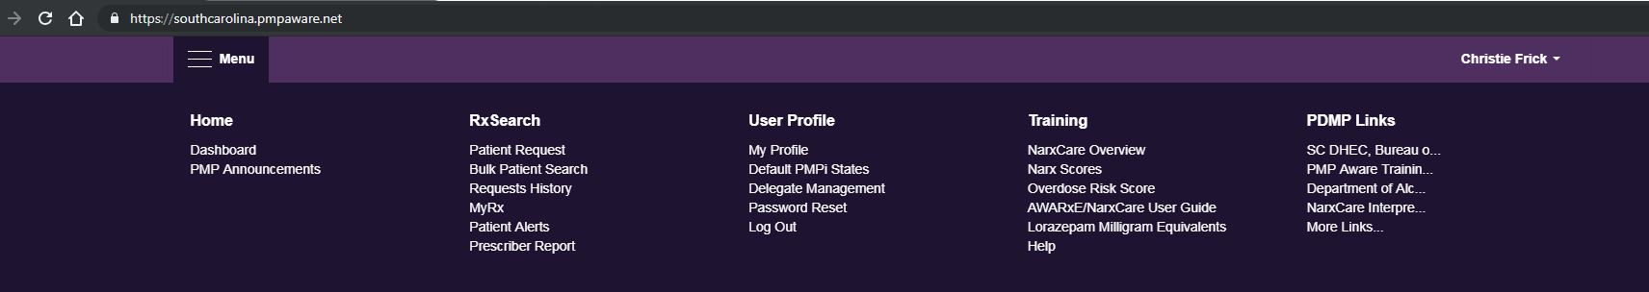

Slide 22
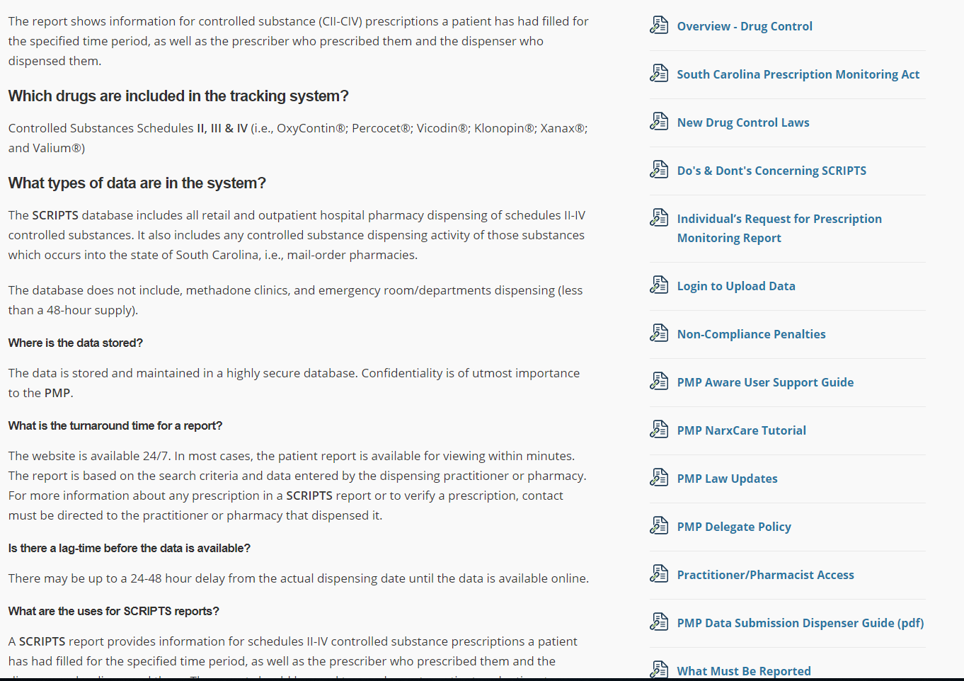

Slide 23
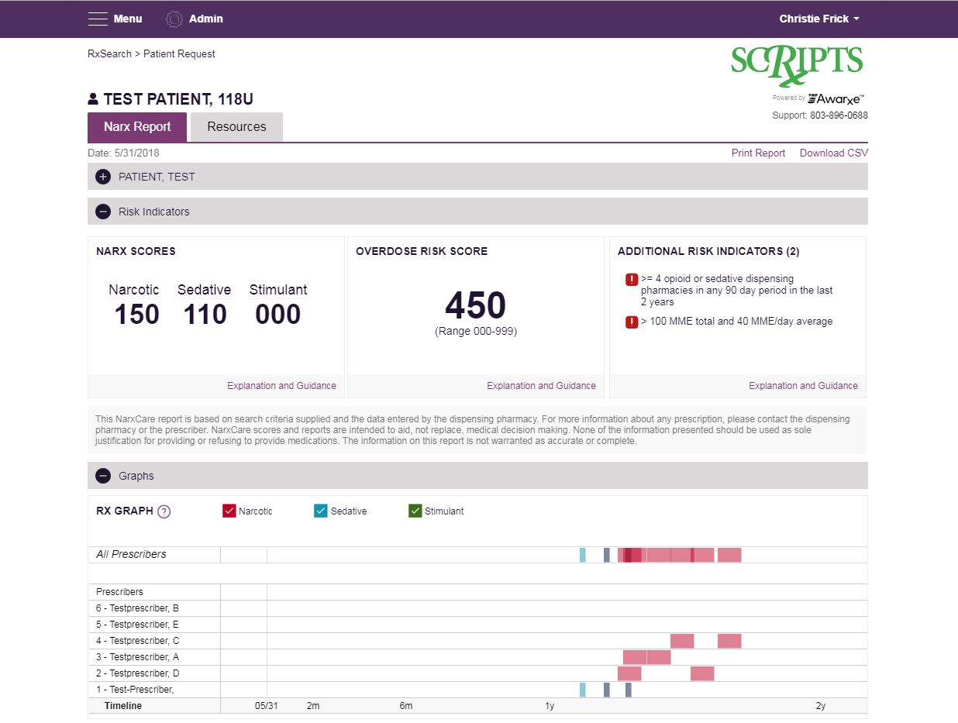

Slide 24
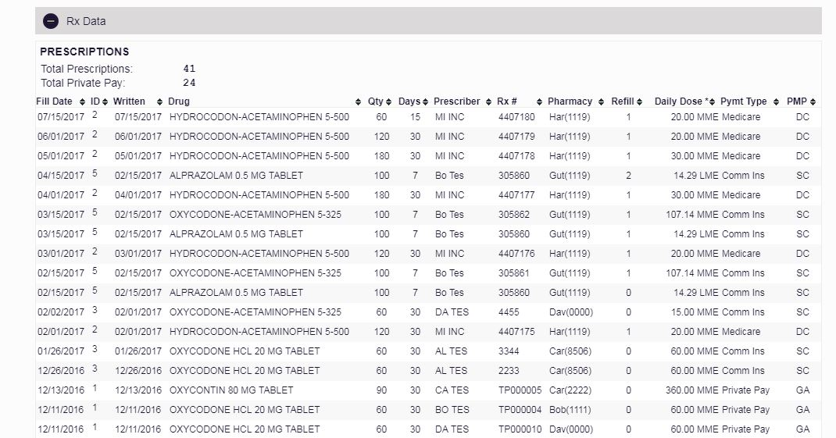

Slide 25
What should I do if I can’t find my patient?
Use patient full first name, last name, and date of birth
Use partial name search, must use at least 3 characters in first and last name fields (make sure you check the partial spelling box for first and last name)
Use MyRx to see what name the prescription is filled under. Will also tell you which pharmacy so you can call them for DOB.
Call us – 803-896-0688

Slide 26
Important Tips
Write animal’s date of birth on all prescriptions.
Contact the dispenser to verify information on the SCRIPTS report.
Don’t ever give out a SCRIPTS report.
Don’t query anyone except your own patients, animals only.
Have delegates register and use their own account. Don’t ever share your account information or password.

Slide 27
PMP Clearinghouse - The Dispenser’s Portal
https://pmpclearinghouse.net/users/sign_in

Slide 28
Reporting by Dispensing Veterinarians
Can report electronically through PMP Clearinghouse by Universal Claim form or by uploading an ASAP file.
Must apply for a waiver to be allowed to report with a paper Universal Claim Form (UCF) if you can not report electronically.
The dispenser should use the animal’s name, its’ owner’s address and the animal’s actual date of birth. If you only have the month and year of birth, please be consistent with the dates you use for this specific animal.
All required fields will have an * beside them.

Slide 29
Reporting by Dispensing Veterinarians
Must report daily but only on days open for business.
Zero report if you do not have any dispensings for that day.
If you never dispense, you do not have to zero report. You can submit an Exemption form so we will know that you do not dispense.
Required fields include a prescription number. This number can be any number as long as it is unique.

Slide 30
Reporting by Dispensing Veterinarians
The owner of the drugs (whatever DEA is used to purchase drugs) will always be the DISPENSER, or the pharmacy.
The veterinarian that is treating the patient and authorizes the medication is the PRESCRIBER.
The animal is the PATIENT. Remember to report animal’s name and DOB, not owner.

Slide 31
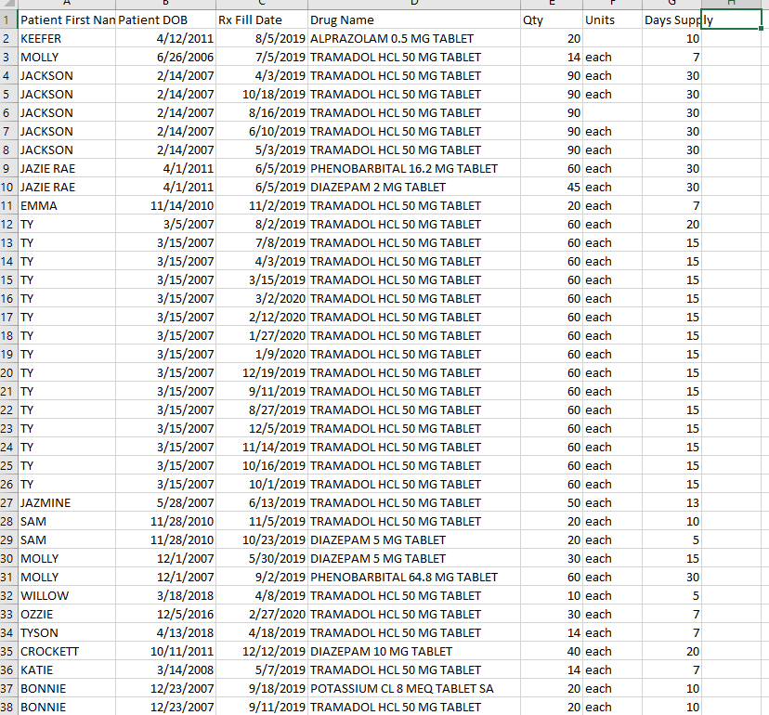

Slide 32
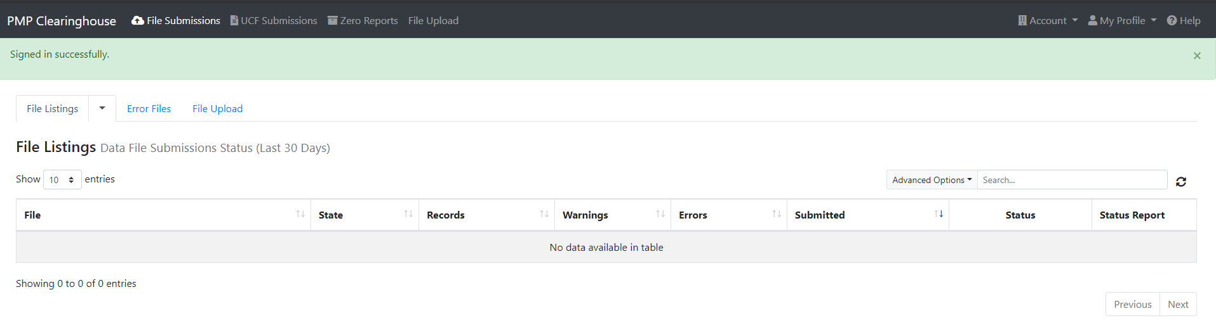

Slide 33
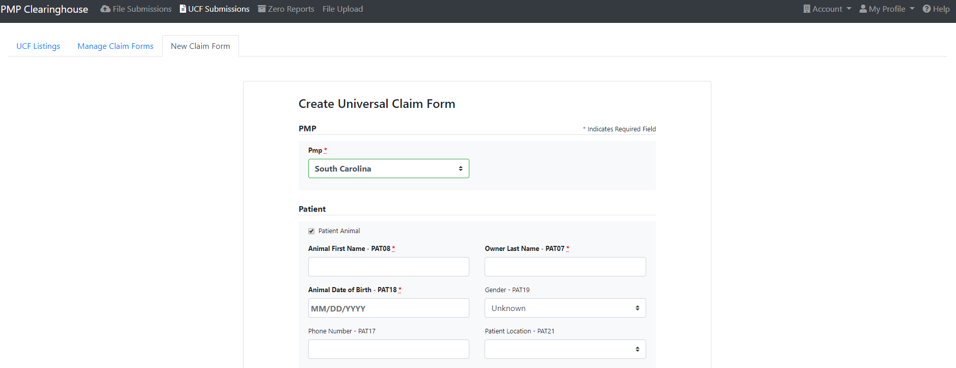

Slide 34
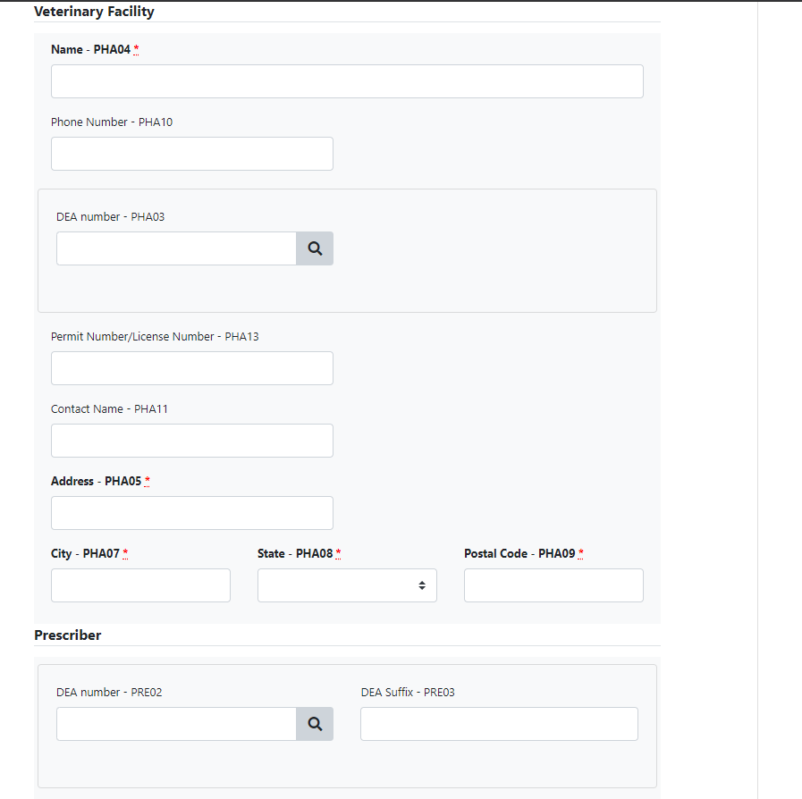

Slide 35
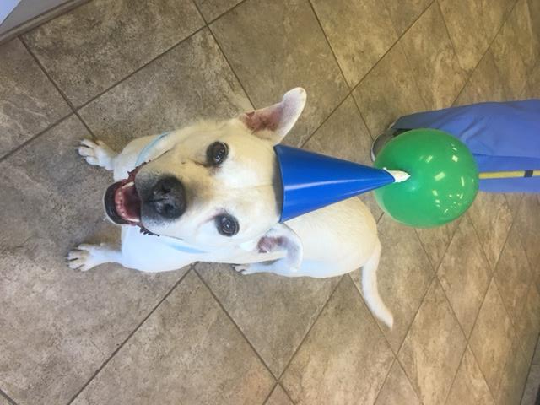
CASE STUDY

Slide 36
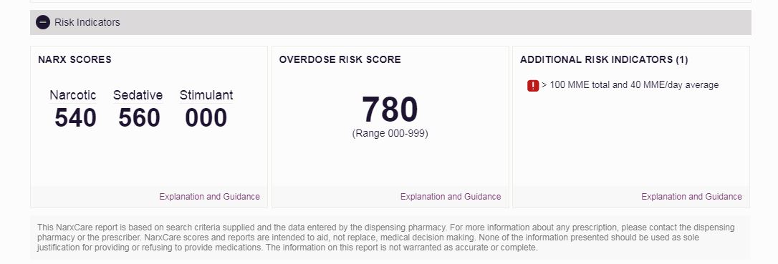
This is an actual patient.

Slide 38
Penalties for non-reporting or unlawful use of PMP data
Section 44‑53‑1680.(A) A dispenser who knowingly fails to submit prescription monitoring information to drug control as required by this article, or who knowingly submits incorrect prescription information, is guilty of a misdemeanor, and upon conviction, must be fined not more than two thousand dollars or imprisoned not more than two years, or both.
(B) A person or persons authorized to have prescription monitoring information pursuant to this article who knowingly discloses this information in violation of this article is guilty of a felony and, upon conviction, must be fined not more than ten thousand dollars or imprisoned not more than ten years, or both.

Slide 39
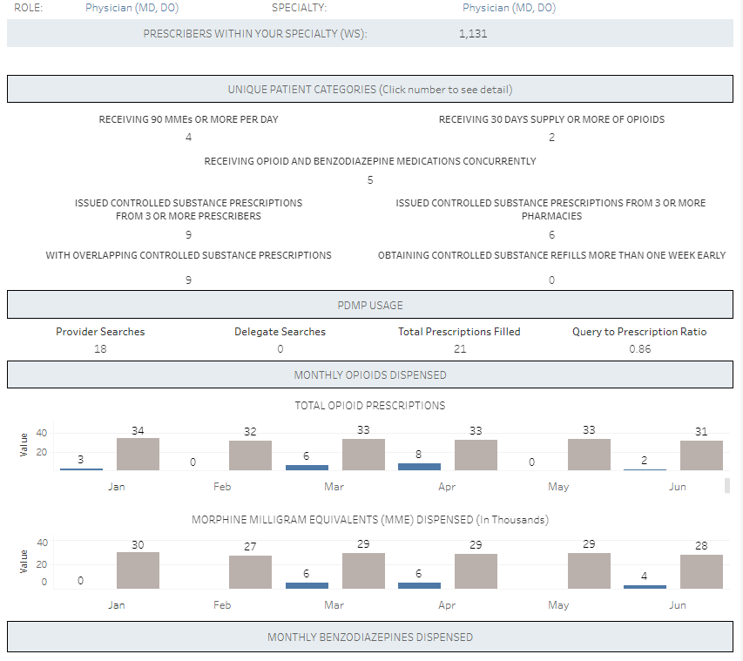

Slide 40
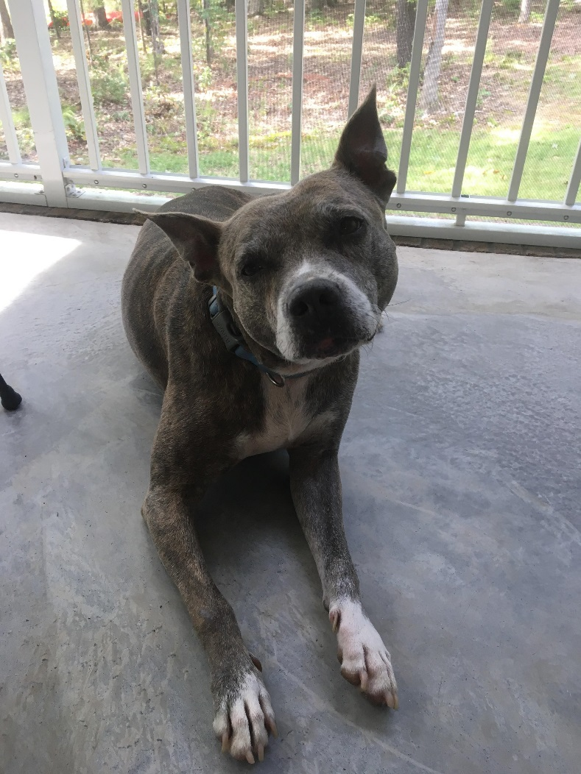
Questions?

Slide 41
Contact Us
Christie Frick, RPh, PMP Director
Tracie Paschall, CPhT, Program Coordinator
803-896-0688
scripts@dhec.sc.gov
www.dhec.sc.gov/scripts

